Slide 1




CPD9
Generative AI in Higher Education
Aim: Education Strategy and Employability
Duration: 2 ½ hours
Audience: Lecturers, Course Leaders
Placeholder EP

Slide 2


Learning Outcomes
Understand the fundamental concepts of Gen AI and its applications in education.
Explore how Gen AI can enhance learning, teaching, and assessment.
Discuss strategies for maintaining academic integrity when using Gen AI in assessment.
Develop rubrics to assess Gen AI-assisted student work.
Identify ways to guide students in the ethical and creative use of Gen AI tools.
Placeholder EP

Slide 3
Content
What is Gen AI and introducing some of the major technologies
Gen AI and copyright, GDPR and IP
How students are using Gen AI in their studies
Examples of how Gen AI can be used for teaching
Gen AI and prompts
Academic Integrity in the age of Gen AI
Gen AI and assessment - thoughts and reflections
BSU approaches to Gen AI in their educational provision

Slide 4



What is Artificial Intelligence (AI)? (1)
There has been an explosion of AI tools and the integration of AI into current tools.
AI in Higher Education often refers to the use of tools built on large amount of data that work on pattern recognition, prediction and learning. These then become generative to be able to create outputs. Known as Generative AI.
There are a huge number of solutions and the best known are shown here.

Slide 5
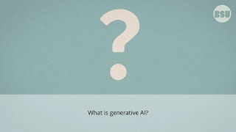
What is Artificial Intelligence (AI)? (2)
An intro to Generative AI video produced by BSU and aimed at students.

Slide 6

Interactive Activity (1)
In groups, spend ten minutes exploring your current experiences of using Gen AI tools. It will be good to focus on:
Which tool did you use?
Why did you choose that one?
What did you use it for?
What was the output like?
Any advice for someone wanting to do the same thing again?
Please put your experiences in the session PADLET.
Notes:
]

Slide 7

Important considerations
There are three important considerations before using Gen AI for learning, teaching and assessment:
  GDPR and data privacy
  Copyright
  Intellectual property

Slide 8
GDPR and data privacy
BSU and _______ have strict rules and policies on GDPR and data privacy. Please see your mandatory training. Importantly:
  Student & staff personal data should not be shared with non-institutional tools.
  The use of any Gen AI tool which requires the use of any identifiable information needs to be approved by your data protection officer

Slide 9
Copyright
Many Gen AI tools use data supplied by end users for training and developing their models. It is important to know how any data (uploaded, spoken, typed and cut & paste) will be used and stored.
Lectures, research content and other institutional material are owned by the institution and should not be shared. Use needs to be approved by your data protection officer and for copyright materials these need to be used within a ring-fenced tool (not shared).

Slide 10
Intellectual Property
This is very similar to copyright material but the question that needs to be asked is ‘do I have the necessary permissions to uploaded this content into an AI tool?’
It is possible that uploading content is passing over copyright and could have significant impact - for example any code, data, ideas, research etc, that could otherwise be used for publication and/or income generation, Always check if not sure.

Slide 11
Interactive Activity (2)
What is the worst thing that can happen?
This is a great activity to use to reflect on personal AI activities but also with students. In groups explore the worst case scenarios of using a Gen AI tool. For example:
  I used student names and grades and these were then published in a news article
  I accidentally gave away the IP which was worth £millions
  I am being sued by the author of copyright material I put into Gen AI.
Please put your experiences in the session PADLET.

Slide 12
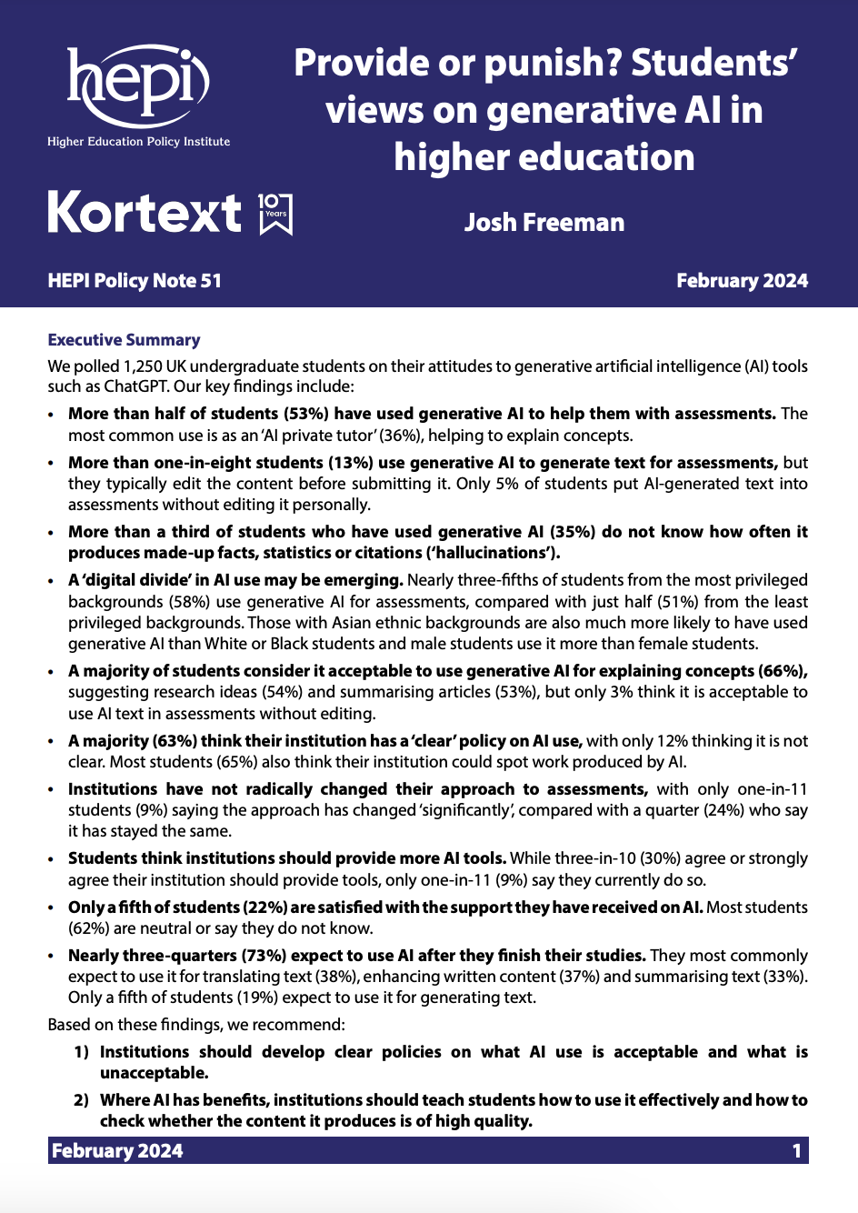
How are students using Gen AI?
Hepi and Kortex surveyed 1,250 UK undergraduate students on their attitudes to (AI) tools such as ChatGPT.
‘...More than half of students (53%) have used generative AI to help them with assessments. The most common use is as an ‘AI private tutor’ (36%), helping to explain concepts.
More than one-in-eight students (13%) use generative AI to generate text for assessments, but they typically edit the content before submitting it. Only 5% of students put AI-generated text into assessments without editing it personally.’
Notes:
This is a very insightful report and worth reading - including different uses of AI based on demographics.

Slide 13
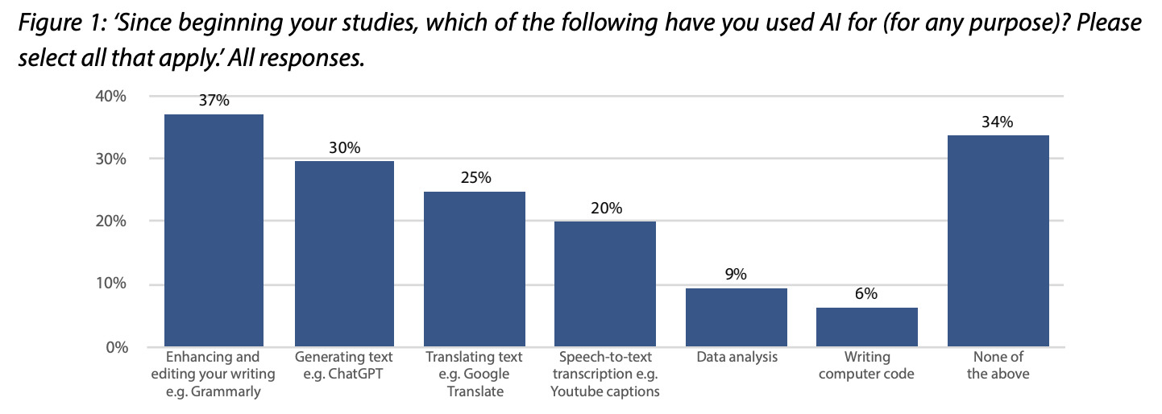
How are students using AI? (1)
https://www.hepi.ac.uk/wp-content/uploads/2024/01/HEPI-Policy-Note-51.pdf

Slide 14
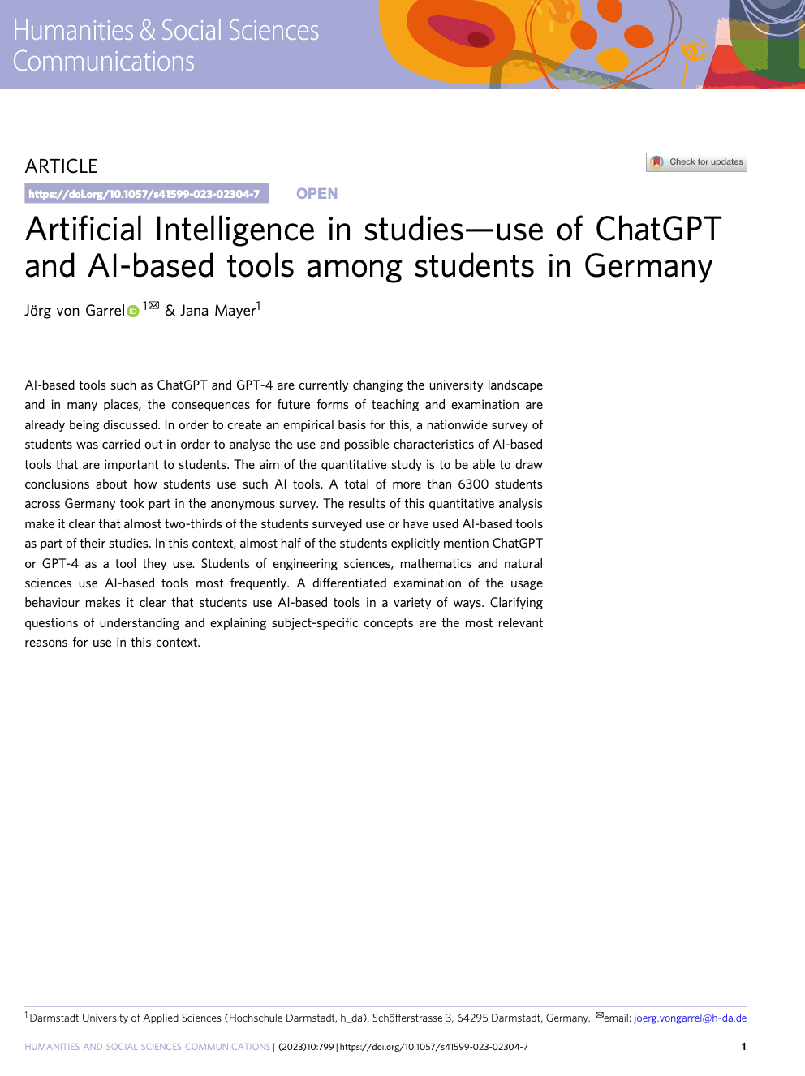
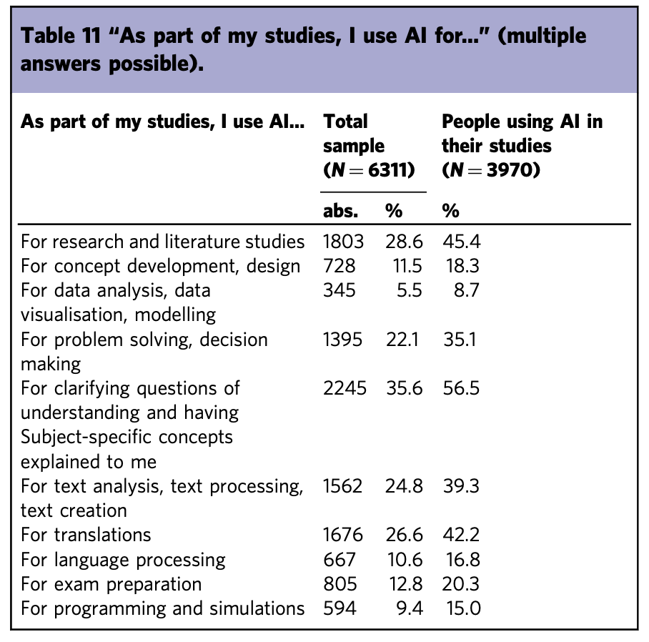
How are students using AI? (2)
von Garrel, J., Mayer, J. Artificial Intelligence in studies—use of ChatGPT and AI-based tools among students in Germany. Humanit Soc Sci Commun 10, 799 (2023).
https://doi.org/10.1057/s41599-023-02304-7

Slide 15
The AI continuum
The explosion of AI tools has led to institutional process changes – for example student support, teaching and assessment.
AI is not going to go away, and so integrating AI into higher education to support the success of future graduates whilst protecting the integrity of their awards is a common approach.

Slide 16
Transparency
It is important students feel supported in their use of AI and this needs to come from the comfort and confidence of their lecturers.
Open conversations with students, perhaps integrated at the start of a module, are essential – include the do and don'ts, explore AI hallucinations and the global challenges.
Engender excitement and opportunity not suspicion and disdain.

Slide 17
AI and teaching (1)
There are so many creative ways AI and Gen AI can be used in teaching and learning. It is up to you to identify approaches that enrich and enhance learning whilst also supporting students to develop GenAI skills.
Using AI tools will promote AI literacy and support students’ employability and professional development. Additionally, it can actually help with academic integrity through the knowledge of AI’s limitations and institutional expectations.

Slide 18
It’s all about the prompts
A core part of AI (depending on the tool being used) is knowing how to engage with it. Criticality in the creation and application of prompts to get the best out of an AI tool is often taught.
CONTEXT
TASK
INSTRUCTION
OUTPUT
REFINE
Define the context of the task. Who is asking the questions and why?
Detail the specific task that is required giving as much information but not instruction
This is the complex part - generate detailed instructions to get the right output.
What do you want it to produce? What format? Size? Type of audience?
Refine the outputs by updating. Remember, what is the worst that can happen?

Slide 19
AI and teaching (2)
Give students a task and let them try any AI tool to complete it. Reflect on their experiences in a class discussion
Use AI to generate text and then ask students to grade it using the module marking scheme
Use AI to generate formative MCQs and upload these into your VLE. Check with the DPO first
Battle of the AIs. In groups ask them to complete a task using a specific AI tool. Discuss and compare outputs
Generate AI referenced text and ask students to explore the references. How many of the references are real?
Use AI to generate a series of revision flash cards - ask students to create their own and share
Give students a question and to use AI to tutor them in answering. Then write a 100 word summary with AI. Swap and mark
Ask students to use an AI image generator to best meet a required output. Reflect on the process
Students to put AI text into a chat tool and ask it to refine the language. Compare and contrast noting the changes and reflect on these
Ask students to paste in some assessment feedback they have received and ask for suggestions on how to use it
Give students some data and a set of questions to answer. Use AI to address the questions and then critically evaluate the outputs
Use an AI tool to create an animation/video/code in response to a subject (get DPO permission). Share as a library with the class

Slide 20

BSU suggestions on AI
This is a BSU student video on examples how AI tools can be used ethical as part of student activities.

Slide 21
AI and assessment (1)
This is a large area of focus for all institutions as it can have significant impact at the student, staff, institutional and sector level.
Student | Intentionally or unintentionally pass an assessment, receive a higher grade without knowing the module content. OR students who did not use AI feel disenfranchised.
Staff | Graded assessments made by AI (not a good use of time) or put the institution at risk for not safeguarding standards. Need to design authentic assessment whereby there is confidence the work is that of the student.
Institutional | Worst case, OfS and other external involvement for not protecting standards and wrongly giving awards. Loss of degree awarding powers and reputation damage.
Sector | Graduates in the workplace not knowing what they are doing and so (1) perform poorly or (2) put others at risk - healthcare, engineering, other…

Slide 22
AI and assessment (2)
There are a number of challenges associated with assessment following the growth of AI tools.
The challenges increase in parallel with the complexity of learning outcomes and therefore academic level.
AI tools can easily generate text, answer MCQs as well as create resources – so how do we change our assessment practices to give us confidence the students are doing the work?

Slide 23
AI and assessment (3)
UCL have ‘six changes you can do now’ for assessment in the AI age [link to page]. Assessment re-design is the preferred approach to managing assessment in the AI age.
Discuss Academic Integrity and AI with your students
Feedback and formative assessment
Revise exam questions (hypotheticals/scenarios/problems)
Revise essay questions (based on experience, include generation)
Convert generic questions to scenario-based questions
Upgrade your Multiple Choice Questions (MCQs)

Slide 24

AI and academic integrity (1)
An video on AI produced by BSU and aimed at students with a focus on academic integrity.

Slide 25
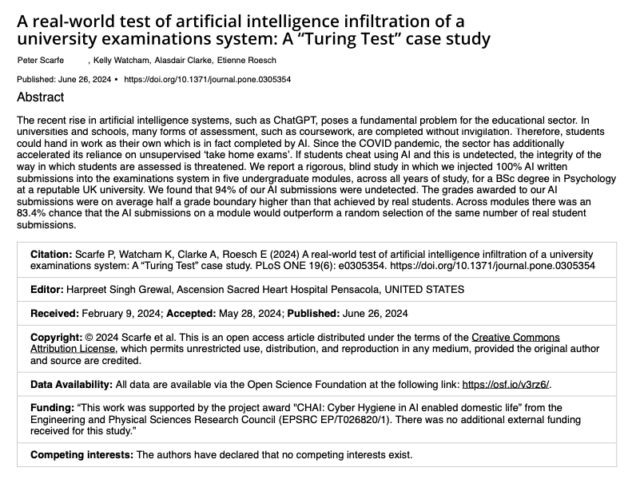
AI and academic integrity (2)
Article Source: A real-world test of artificial intelligence infiltration of a university examinations system: A “Turing Test” case study
Scarfe P, Watcham K, Clarke A, Roesch E (2024) A real-world test of artificial intelligence infiltration of a university examinations system: A “Turing Test” case study. PLOS ONE 19(6): e0305354. https://doi.org/10.1371/journal.pone.0305354
‘.....went undetected in 94% of cases and, on average, attained higher grades than real student submissions’

Slide 26
AI and academic integrity (3)
For online assessments, some institutions are deploying Safe Exam Browsers (SEB) and/or using virtual exam machines or remote proctoring.
These approaches can reduce students using AI tools when they are not supposed to, but these can be expensive and/or challenging to deploy. SEB is free and sites can be blacklisted.
Invigilators need training in how to spot non-supported AI usage.

Slide 27

Integrate AI in assessment
A common approach that is being used is whereby students are asked to critically evaluate outputs generated by AI for their submission. This is where the student submits the prompts they used (which can also be used as part of the assessment) as well as the output. Finally a critical analysis of the output and this could be through an applied framework or lens.

Slide 28
Interactive Activity (3)
In groups, spend ten minutes exploring your current assessment processes you use – reflect on the following:
Can this assessment be successfully completed by AI?
What changes can be made to the assessment, or the assessment process, to support academic integrity?
Will the proposed changes in impact the usefulness of the assessment?
Please put your experiences into the following template.
Notes:
What elements of these 7 Principles are already operating in your institution. Different names + similar intention

Slide 29
Interactive Activity (4)
Assessment | Proposed changes in response to AI | Impact on the authenticity/ impact of the assessment
Notes:
What elements of these 7 Principles are already operating in your institution. Different names + similar intention

Slide 30
We asked ChatGPT what type of tasks it is bad at text from ChatGPT 4
Highly Creative or Subjective Artistic Work
  Tasks requiring unique artistic styles or mimicking specific creators whose work postdates 1912 (e.g., modern artists).
  Producing truly novel or subjective art pieces like poems or narratives that require deep human emotions.
Real-Time Situational Context
  Context-dependent tasks where I can't observe or understand the full environment (e.g., live tutoring where instant adjustments depend on subtle, unshared inputs).
Personalised Memory-Dependent Assistance
  Tasks requiring long-term memory of user interactions if my memory is not enabled.
Complex Multi-System Coordination
  Tasks requiring coordination with multiple, proprietary, or restricted systems that I can’t directly interact with (e.g., corporate intranet operations).
Sensitive or Legally Restricted Domains
  Legal advice, medical diagnoses, or tasks requiring certifications (e.g., prescribing medication or preparing legal contracts).
Highly Specialized Niche Domains
  Deep expertise in hyper-specialised fields I haven’t been explicitly trained on, or which have emerged post-2023, like newly developed technologies.
Physical Execution
  Anything requiring physical interaction with the real world (e.g., repairing hardware, assembling products)

Slide 31
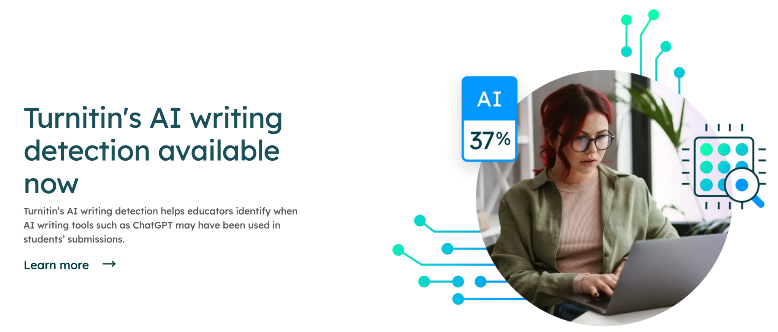
AI detection software (1)
Turnitin is used by BSU but the AI detection tool is not used for detection. Instead there is a reliance on academic judgement.
This emphasises the importance of assessment design and marking processes are key for maintaining and protecting academic standards,
https://www.turnitin.co.uk/solutions/topics/ai-writing/
Notes:
Text and image from Christina Owen from BSU

Slide 32
AI detection software (2)
A recent article in the Guardian summarised some key issues (please see the article for resources)
‘cases appeared to be soaring at Russell Group universities, some of which had reported a 15-fold increase in cheating’
‘Turnitin has processed more than 130m papers and says it has flagged 3.5m as being 80% AI-written. But it is also not 100% reliable; there have been widely reported cases of false positives and some universities have chosen to opt out. Turnitin says the rate of error is below 1%,’
Notes:
Text and image from Christina Owen from BSU

Slide 33
AI detection software (3)
A recent article in the Guardian summarised some key issues (please see the article for resources)
‘evidence that suggests AI detection tools disadvantage certain demographics. One study at Stanford found that a number of AI detectors have a bias towards non-English speakers, flagging their work 61% of the time, as opposed to 5% of native English speakers (Turnitin was not part of this particular study).’
‘Neurodivergent students, as well as those who write using simpler language and syntax, appear to be disproportionately affected by these systems.’
Notes:
Text and image from Christina Owen from BSU

Slide 34
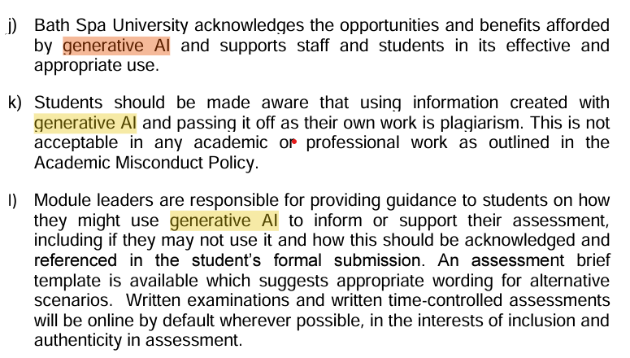
BSU Policies
Academic Misconduct Policy
Effective use of Generative AI for higher education
Guidance for students from the Academic Skills team
Notes:
Text and image from Christina Owen

Slide 35
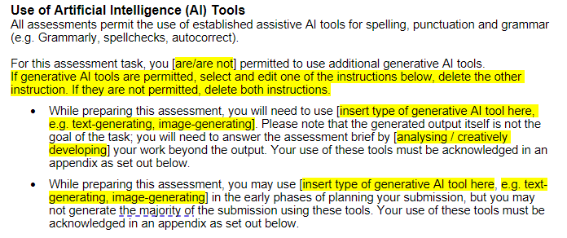
BSU assessment approach (1)
Notes:
Text and image from Christina Owen from BSU

Slide 36
BSU assessment approach (2)
If you suspect something has been written by AI and the student has not followed the BSU guidelines, it is important to raise this following the appropriate route. Please see the BSU the Academic Misconduct Policy.
It is important not to make assumptions, or pre-judge an outcome - the investigation which will determine if there has been an infraction.
For summative work, it is important you do not approach the student directly but instead, follow the process.
Notes:
Text and image from Christina Owen from BSU

Slide 37
AI detection software
A recent article in the Guardian summarised some key issues (please see the article for resources)
‘evidence that suggests AI detection tools disadvantage certain demographics. One study at Stanford found that a number of AI detectors have a bias towards non-English speakers, flagging their work 61% of the time, as opposed to 5% of native English speakers (Turnitin was not part of this particular study).’
‘Neurodivergent students, as well as those who write using simpler language and syntax, appear to be disproportionately affected by these systems.’
Notes:
Text and image from Christina Owen from BSU

Slide 38
Make it yours
Create (or co-create with students) a standard set of AI slides drawing from your own institutional guidelines that can be shared across the institution and used by all lecturers in their learning, teaching and assessment.
Activity engage students with AI practices, policies and rules. Allow students to ask questions, test tools and learn how to use these ethically in their studies.

Slide 39

Summary
AI tools are not going to go away - the approach is to apply criticality and good academic design to integrate these tools into learning, teaching and assessment.
Before using any tool, be clear on its permissions and use of data – seek approval from your DPO where appropriate.
Transparency with students is essential – clear guidelines, expectations, support/guidance and any use of detection tools and penalties.
Learn to enjoy AI and the affordances it offers!

Slide 40
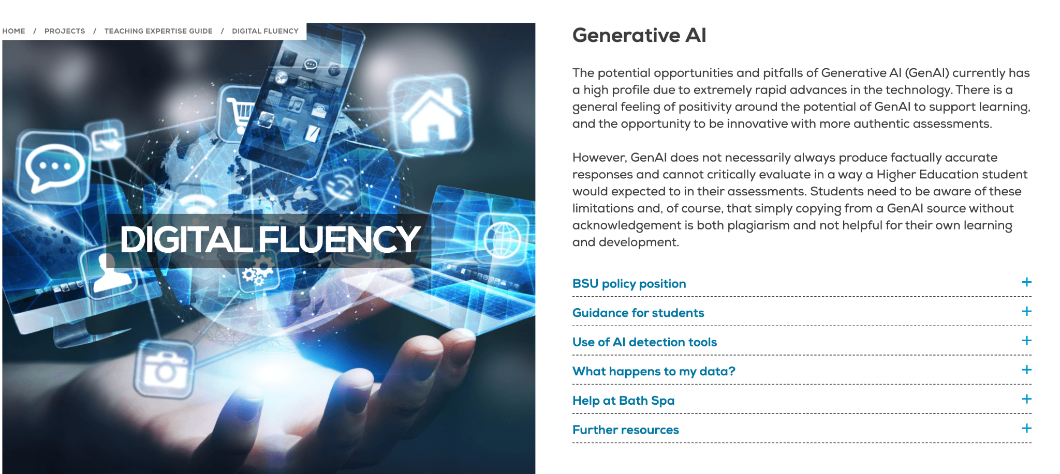
BSU resource
https://www.bathspa.ac.uk/projects/teaching-expertise-guide/digital-fluency/#d.en.138560

Slide 41

Just One Thing
Choose one of the GenAI tools and play with it for 10 mins and enjoy experiencing something new.
41

Slide 42
Resources
https://www.bathspa.ac.uk/about-us/governance/policies/academic-misconduct/
https://www.bathspa.ac.uk/students/ask/genai-guidance
https://www.bathspa.ac.uk/projects/teaching-expertise-guide/digital-fluency/#d.en.138560
https://bathspaonline.sharepoint.com/:b:/r/sites/DigitalFluencyAdvisory-LearningInnovationandSkillsUnit-Staff/Shared%20Documents/Generative%20AI/FINAL%20Guidance%20-%20Effective%20use%20of%20Generative%20AI%20in%20higher%20education%2013-09-23.pdf?csf=1&web=1&e=8K6KMe
https://www.hepi.ac.uk/wp-content/uploads/2024/01/HEPI-Policy-Note-51.pdf
A real-world test of artificial intelligence infiltration of a university examinations system: A “Turing Test” case study Scarfe P, Watcham K, Clarke A, Roesch E (2024) A real-world test of artificial intelligence infiltration of a university examinations system: A “Turing Test” case study. PLOS ONE 19(6): e0305354. https://doi.org/10.1371/journal.pone.0305354
von Garrel, J., Mayer, J. Artificial Intelligence in studies—use of ChatGPT and AI-based tools among students in Germany. Humanit Soc Sci Commun 10, 799 (2023). https://doi.org/10.1057/s41599-023-02304-7
https://www.ucl.ac.uk/teaching-learning/generative-ai-hub/designing-assessments-ai-enabled-world#Changes%20to%20make%20now
https://www.theguardian.com/technology/2024/dec/15/i-received-a-first-but-it-felt-tainted-and-undeserved-inside-the-university-ai-cheating-crisis

