Slide 1




CPD8
Assessment and Feedback
Aim: QA + QE in Assessment
Duration: 2 hours
Audience: Lecturers, Course Leaders
Placeholder EP

Slide 2

Learning Outcomes
Define formative and summative assessment and their role in the assessment process
Articulate best practice in the assessment design
Construct an assessment timeline to develop timed interventions to support student assessment
Discuss an approach for the construction of impactful and meaningful assessment feedback
Discuss elements which support a positive student experience and how these are measured as part of QA processes
2
Notes:
Slide from: Dr Shaun Mudd Lorna Lewis
Teaching Expertise Development

Slide 3
Content
Assessment for learning
Summative and formative assessment
Constructive alignment
Holistic assessment
Constructing good assessment feedback
Good marking practice
Moderation
Feedback model
3
Notes:
Slide from: Dr Shaun Mudd Lorna Lewis
Teaching Expertise Development

Slide 4
Why assessment?
Assessment for Learning
Enables teachers to use information about student’s knowledge, understanding and skills to inform their teaching
Teachers provide feedback to students about their learning and how to improve
Assessment as Learning
Involves students in the learning process where they monitor their own progress, ask questions and practise skills
Students use self-assessment and teacher feedback to reflect on their learning, consolidate their understanding and work towards learning goals
Assessment of Learning
Assists teachers to use evidence of student learning to assess student achievement against learning goals and standards
4
Notes:
Slide from: Dr Shaun Mudd Lorna Lewis
Teaching Expertise Development

Slide 5
Summative & Formative
Formative assessment
Does not count to a student’s grade.
Informs the completion of the summative task
Helps to support student understanding of the assessment task.
Can help with student pacing and meeting deadlines
Engages students with the assessment criteria
Can help to enhance module and degree performance.
Summative assessment
Counts to the module grade and potentially the final degree outcome.
Links to the module specification and validation (cannot be changed without approval)
Subject to intense QA and QE
Needs clear management and student support.
Requires clear understanding for all the markers
Often requires external examiner approval
5
Notes:
Slide from: Dr Shaun Mudd Lorna Lewis
Teaching Expertise Development

Slide 6
NUS Assessment charter (1)
Formative assessment and feedback should be used throughout the programme.
Students should have access to face-to-face feedback for at least the first piece of assessment each academic year.
Receiving feedback should not be exclusive to certain forms of assessment.
Feedback should be timely.
Students should be provided with a variety of assessment methods.
6
Notes:
Teaching Expertise Development

Slide 7
NUS Assessment charter (2)
There should be anonymous marking for all summative assessment.
Students should be able to submit assessment electronically.
Students should be supported to critique their own work.
Programme induction should include information on assessment practices and understanding marking criteria.
Students should be given a choice of format for feedback.
7
Notes:
Teaching Expertise Development

Slide 8
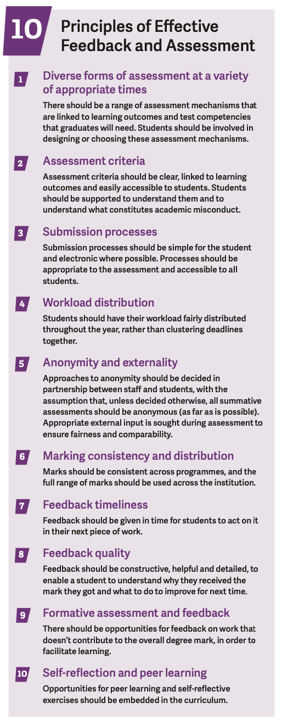
NUS Assessment & Feedback Tool
https://www.qaa.ac.uk/docs/qaas/focus-on/nus-assessment-and-feedback-benchmarking-tool.pdf?sfvrsn=f37cf481_14
8
Notes:
https://www.qaa.ac.uk/docs/qaas/focus-on/nus-assessment-and-feedback-benchmarking-tool.pdf?sfvrsn=f37cf481_14

Slide 9
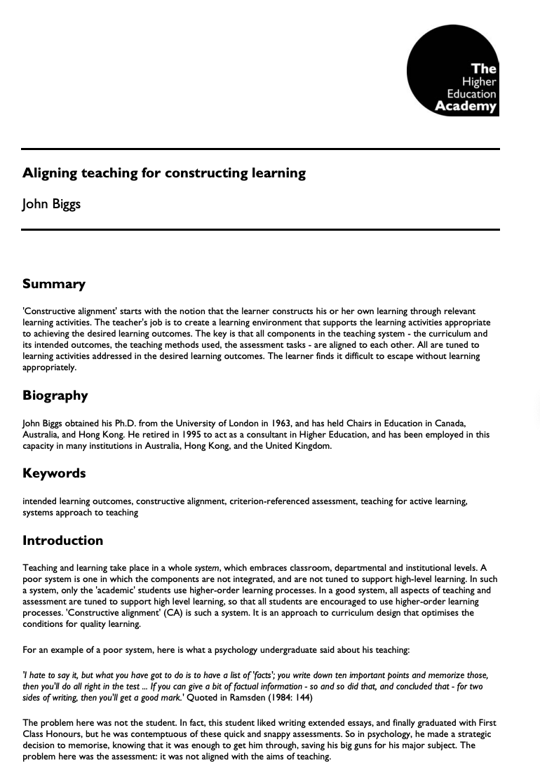
Designing assessment
When designing and planning assessment for a module there are a number of important considerations to consider.
A lot of these relates back to constructive alignment. See Biggs and Tang (2011) - Adapted from Biggs (1999) and Houghton (2004).
This is where the teaching activities, student learning and assessment are aligned whereby the learning activities align with the ILOs and therefore the assessment.
https://www.advance-he.ac.uk/knowledge-hub/aligning-teaching-constructing-learning
9
Notes:
Teaching Expertise Development

Slide 10
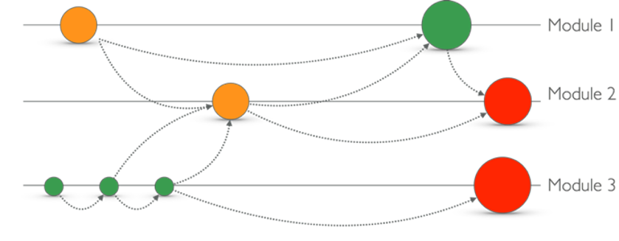
Holistic assessment
Based on work from Uni of Herts & Greenwich.
Green = lower stake | Amber = higher stake | red = high stake
Assessments in a degree need to link together
10
Notes:
Teaching Expertise Development

Slide 11
(OfS) B4 Effective Assessment, Credible awards
Students are assessed effectively
Each assessment is valid and reliable
Academic regulations are designed to ensure that relevant awards are credible
Academic regulations are designed to ensure the effective assessment of technical proficiency in the English language
Relevant awards granted to students are credible at the point of being granted and when compared to those granted previously.
11
Notes:
Teaching Expertise Development

Slide 12
(OfS) B5 Sector recognised standards
Part A - Threshold standards:
A1 Conventions for qualification titles at each level (4-8)
A2 Typical volumes of credit for HE qualifications at each level (4-8)
A3 Qualification descriptors
Part B – Classification descriptors
Typical skills and attributes for each classification for Level 6 bachelors’ degrees
12
Notes:
Teaching Expertise Development

Slide 13
Assessment timeline
Assessment launch & FAQs
Formative assessment
Drop-in support
1
2
3
4
5
6
7
8
9
10
11
12
Assessment check-in & iLO activity.
Online forum via VLE
Summative submission
13
Notes:
Slide from: Dr Shaun Mudd Lorna Lewis
Teaching Expertise Development

Slide 14

Activity: Managing the journey
Running module assessment is like being a project manager.
Effective and planned communication is critical. Repetition and reinforcement are often required as well as signposting.
Peer student and student agency are key areas to develop.
Based on the timeline on the previous slide, discuss in groups activities, interventions or resources which can be developed and given to students. Put idea on a ppt slide as part of a co-creation activity. Present back to the group
14

Slide 15
Giving feedback to students
We give feedback to students but unless they fail they are not able to re-submit their work - so how is the feedback useful? It needs to feed forwards to support future activities, modules and potentially employability.
Importantly, and as part of the NSS, we need to support students to:
Identify when they are receiving feedback (verbal, written, other)
Develop feedback literacy
Apply their feedback to their studies
15
Notes:
Slide from: Dr Shaun Mudd Lorna Lewis
Teaching Expertise Development

Slide 16
Juwah’s Seven principles (1)
Facilitates the development of self-assessment (reflection) in learning.
Encourages teacher and peer dialogue around learning.
Helps clarify what good performance is (goals, criteria, expected standards).
Provides opportunities to close the gap between current and [pursue] desired performance.
Juwah et al. (2004)
16
Notes:
Slide from: Dr Shaun Mudd Lorna Lewis
Teaching Expertise Development

Slide 17
Juwah’s Seven principles (2)
Provides opportunities to close the gap between current and [pursue] desired performance.
Delivers high quality information to students about their learning.
Encourages positive motivational beliefs and self-esteem.
Provides information to teachers that can be used to help shape the teaching [diagnostic].
Juwah et al. (2004)
17
Notes:
Slide from: Dr Shaun Mudd Lorna Lewis
Teaching Expertise Development

Slide 18
Giving feedback to students (1)
SUBJECT FEEDBACK
LOGISTICAL FEEDBACK
STRATEGIC FEEDBACK
This is feedback on their assessment and in particular in relation to the module learning outcomes and the assessment criteria.
It is about the work and not the student. Avoid ‘I’ and ‘You’ when giving this type of feedback unless the assessment modality requires it.
This is also feedback on their assessment but with a focus on the operational elements. For example, structure, spelling, grammar, referencing, formatting and other non-subject specific elements.
This is also a good place to link to their formative feedback.
This is where feedback should become feedforward and give students actions to enhance further their performance.
Additionally, it is good practice to identify future modules and and assessment whereby they can deliver and target their actions.
18

Slide 19
Giving feedback to students (2)
SUBJECT FEEDBACK
LOGISTICAL FEEDBACK
STRATEGIC FEEDBACK
This is feedback on their assessment and in particular in relation to the module learning outcomes and the assessment criteria.
It is about the work and not the student. Avoid ‘I’ and ‘You’ when giving this type of feedback unless the assessment modality requires it.
This is also feedback on their assessment but with a focus on the operational elements. For example, structure, spelling, grammar, referencing, formatting and other non-subject specific elements.
This is also a good place to link to their formative feedback.
This is where feedback should become feedforward and give students actions to enhance further their performance.
Additionally, it is good practice to identify future modules and and assessment whereby they can deliver and target their actions.
19
Notes:
The two red circles are areas where feedback will help students to understand their received grade.

Slide 20
Good marking practice
A clear rubric aligned to the institution’s grading framework is essential (also share this with students).
When marking, review a couple of pieces of work blind and then discuss the grades with the marking team to explore and confirm standards.
Do no make personal judgements (avoid ‘I’) and overall the grading is based on more than one person,
Give clear constructive feedback knowing that it will be shared with others (staff, students, externals, online).
Where possible, compare to previous year to maintain levels.
20
Notes:
Slide from: Dr Shaun Mudd Lorna Lewis
Teaching Expertise Development

Slide 21

Moderation (1)
Internal Moderation
by Partner
Internal Moderation
by BSU
External Moderation by External Examiner
Accuracy (how closes to the target)
Precision (how close to each other)
21
Notes:
Text from: Dr Shaun Mudd Lorna Lewis
Teaching Expertise Development

Slide 22
Moderation (2)
Information is covered in the BSU policy. (text fom/adapted from the policy)
‘Module Leaders have responsibility for ensuring that summative assignments are double-marked or second-marked where it is appropriate.
This is subject to academic judgement and should be based on the guidance below. However, it should be noted that all summative assignments should be internally moderated.
Where second marking has taken place, moderation is required where three or more markers are within the marking team to ensure consistency’
22

Slide 23
Moderation (3)
Information is covered in the BSU policy.
Double marking - this is for non-written forms of assessment (for example presentations).
Second marking - this is for written submissions.
‘Internal moderation is a process separate from marking and provides assurance that marking criteria have been applied appropriately. It should also reflect the shared understanding of the markers, and an approach which enables comparability across academic subjects (in particular recognising that students may be studying more than one subject).’
23

Slide 24
Moderation- process (1)
Internal moderation ensures that the marking of student assignments is rigorous, fair, reliable, consistent with the marking criteria, and that the grades/ marks awarded are at the appropriate standard.
It should take place BEFORE provisional grades are released to students.
All staff newer to marking should be support and includes in the processes.
The Moderator is not entitled to amend individual marks. However, if Moderators have specific concerns, they should raise these with the original markers but have no right to overrule.
24
Notes:
Teaching Expertise Development

Slide 25
Moderation- process (2)
Should such a dispute occur, with no resolution, a third marker should be invited to adjudicate.
The external examiner should not act as another marker.
Should feedback from the Moderator result in the original markers amending marks for students within the sample, all summative assignments for that cohort will be reviewed by the original markers to check for fairness and consistency of approach.
Marks can be amended at the Subject Board and are therefore provisional until ratified by the Assessment Board
25

Slide 26
Moderation- process (3)
Moderations should be based on a sample which comprises:
  typically 10% or a minimum of 8 assignments taken from the full range of marks awarded.
  All failed assignments should be moderated.
  If 8 or fewer assignments are available, all of these should be moderated.
  Samples should be taken to represent student work at every delivery location (including modules delivered at partner institutions) and every mode of study. Resubmitted work should also be moderated.
26
Notes:
Teaching Expertise Development

Slide 27
Moderation- partners (1)
Partner institutions must ensure that their own internal processes for the approval of assessment tasks and the moderation of student output are rigorous and consistent with the University Assessment and Feedback Policy
Arrangements for moderation by BSU, which must involve at least one member of University staff (usually the link tutor), should be agreed annually with the partner organisation and confirmed at School Quality Management Committees.
All modules at partner institutions, will be sampled for moderation by the University.
27
Notes:
Teaching Expertise Development

Slide 28
Moderation- partners (2)
When determining the sample size for BSU moderation of assessments marked by partner providers, the following criteria will be considered:
  (1) the length of time the partnership has been established
  (2) the length of time the programme has been in operation
  (3) any conditions for moderation as set out at the approval event
  (4) the experience of the lecturer marking the student output
  (5) the level of the module and contribution to the overall degree classification
  (6) the type of student output and the practicalities of implementing the moderation process e.g. art exhibitions and performances.
28
Notes:
In the event of concerns about the quality of provision the University may extend and/or increase levels and duration of second marking and moderation.

Slide 29
Any questions?
29
Notes:
Slide from: Dr Shaun Mudd Lorna Lewis
Teaching Expertise Development

Slide 30

Thank You
Your name
Contact details
04 October 2024

Slide 31
References
https://web.archive.org/web/20201212072520id_/https://www.uky.edu/~rsand1/china2018/texts/Bloom%20et%20al%20-Taxonomy%20of%20Educational%20Objectives.pdf
https://haqaa2.obsglob.org/wp-content/uploads/2020/11/2001_Anderson_A-taxonomy-for-learning-teaching-and-assessing.-A-Revision.pdf
https://quincycollege.edu/wp-content/uploads/Anderson-and-Krathwohl_Revised-Blooms-Taxonomy.pdf
https://s3.eu-west-2.amazonaws.com/assets.creode.advancehe-document-manager/documents/hea/private/resources/id477_aligning_teaching_for_constructing_learning_1568036613.pdf
https://www.enhancingfeedback.ed.ac.uk/documents/id353_senlef_guide.pdf
https://www.bathspa.ac.uk/media/bathspaacuk/about-us/policies/academic-and-student/Assessment-and-feedback-policy.pdf
31
Notes:
Teaching Expertise Development

Slide 32

Just One Thing
Think about the assessment you remember the most from when you attended university. Why do you remember this? What can you learn from this reflection? Was it a good or bad experience?
32

