Slide 1
CPD4 Quality and Standards - Through a Student Journey
Aim: Quality Assurance (QA) + Quality Enhancement (QE) in Assessment
Duration: 2 hours
Audience: Lecturers, Course Leaders
Notes:
Slides from Pearl Slater - Head of Academic Governance and Quality

Slide 2
Aims of the session
In this session, we will explore:
External Context for HE Regulation
The Office for Students and the B Conditions
Academic Governance and Quality Team
Quality and Standards - Through a Student Journey
2
Notes:
External Context for HE Regulation
Role of the Academic Governance and Quality Team
B Condition Compliance Through a Student Journey
talk for about 20 - 25mins; have some questions at the end. lots of slides but these can be a resource. please do make sure you ask questions even if these feel obvious, it can be a complex topic;

Slide 3
UK HE Regulation
All Higher Education in the UK has a regulatory body responsible for setting and assessing quality and standards.
The Quality Assurance Agency (QAA) is the Regulatory Body for Scotland, Wales and Northern Ireland.
English Regulatory Body for HE is the Office for Students (OfS). QAA acts as Designated Quality Body (DQB) until March 2023.
3
Notes:
regulatory arrangements are different for england in comparison to the rest of the UK.
The QAA regulates quality and standards for Scotland, Wales and Northern Ireland. The OfS is the english regulatory body (established by Higher Education and Research Act (HERA) 2017) Herand the QAA acts as the Designated Quality Body until end of March 2023; after which OfS will act as interim assessor of quality and standards. The QAA uses the Quality Code as its Framework for the nations apart from England; and Ofs uses the regulatory framework. Established by the Higher Education and Research Act (HERA) 2017.

Slide 4
OfS Primary Regulatory Objectives
Are supported to access, succeed in, and progress from, higher education.
Receive a high quality academic experience, and their interests are protected while they study or in the event of provider, campus or course closure.
Are able to progress into employment or further study, and their qualifications hold their value over time.
Receive value for money.
4
Notes:
OfS has four primary regulatory objective (READ); these are the wider contextual backdrop to all of the conditions that the OfS sets for universities, and are essentially the purpose of the regulatory framework.

Slide 5
Conditions of Registration (1)
Office for Students set Initial and Ongoing Conditions. The CoR are set out in themes:
A – Access and participation
B – Quality, standards & student outcomes
C – Protecting student interests
D – Provider financial sustainability
E – Good governance
F – Information for students
G – Accountability for fees and funding
5
Notes:
conditions set out from A - G; we’re going to be focusing on B conditions around quality, standards and student outcomes. also pick up on C1 which relates to how we comply with consumer law, as students are consumer under the law

Slide 6
Conditions of Registration (2)
B Condition | Summary
B1 | Ensuring a high-quality academic experience for students.
B2 | Resources, support, and effective engagement in and beyond HE.
B3 | Deliver successful outcomes – valued by employers/further study.
B4 | Effective assessment, credible awards
B5 | Reflect sector-recognised standards.
B6 | Participate in Teaching Excellence. Framework.
C1 | Take account of guidance from the CMA about consumer legislation
6
Notes:
six B conditions, B1 and B2 are about high quality academic experience for students; ensuring that we provide all the necessary resource and support for student to engage effectively in HE and go on to be successful beyond HE
b3 is about student outcomes, which we’ll look at in more detail later on; it’s about students continuing and completing their studies successfully,
B4 and B5 are around we set, maintain and assess academic standards and give out credible awards that reflect UK standards - we’ll cover this in more detail
B6 is participation in the teaching excellence framework; not going to cover in great detail, this is something that we take part in every five years, many of the ways in which we support students to achieve successful outcomes are also evidenced in our tef submission.
c1 is about students as consumers; how do we ensure that we take account of guidance around consumer legislation and ensure students rights are protected

Slide 7
Academic Governance and Quality Team (1)
Pearl Slater
Head of Academic Governance and Quality
Gavin Harrison
Deputy Head of Academic Governance and Quality (Educational Partnerships)
Terri-Anne Jones
Academic Quality Advisor
Joshua Steeds
Academic Quality Advisor
Rachel Clarke
Academic Governance and Quality Administrator
Matthew Holt
Academic Governance and Quality Manager
Anthony Clements
Academic Quality Advisor (Educational Partnerships)
Nicky Lake
Academic Quality Advisor
7
Notes:
Part of Governance, Legal and Compliance Team - report to the University Secretary. Very close working relationships with PVC Academic Planning and PVC Student Experience to deliver
Newly expanded - two posts dedicated to supporting the frameworks that ensure academic compliance and risk management for our partnership provision - Gavin and Anthony
Academic Quality Advisors have key links with certain Schools
Fully staffed team with four new starters since January

Slide 8
Academic Governance and Quality Team (2)
Responsible for the frameworks, policies and procedures that support the University in complying with external regulatory requirements for quality assurance and academic standards.
Academic Governance
Academic Policy
Quality Assurance and Academic Standards
Key cross university working relationships to deliver on our work
8
Notes:
Responsible for the frameworks, policies and procedures that support the University in complying with external regulatory requirements for quality assurance and academic standards.
Academic Governance (Academic Board and Sub-Committees)
Academic Policy (student policies for awarding, assessment)
Quality Assurance and Academic Standards (programme approval, change, review, closure)
Key cross university working relationships to deliver on our work

Slide 9
Academic Governance and Quality Team (3)
Strategy 2030 - Strategic Priorities
B3 Metrics and Student Experience
Development of educational partnerships
Enhancement of external profile
Recruitment and retention
9
Notes:
The B3 metrics and student experience priority underpins the key driver for the programme review process (see ‘Programme Review’).
2. The stabilising and development of educational partnerships is reflected in the plans to
strengthen academic compliance and improve partnership operations (see ‘Partnership Approval
and Management’)
3. The enhancement of our external profile is supported by the development of new programme provision and regulations and procedures to meet the Lifelong Learning Agenda (see ‘Programme Approval’).
4. Recruitment and retention is supported through the Programme Review process with analysis of course level recruitment and marketing activities, and continuation rates. Undertaking policy review and reporting outcomes from progression, withdrawal, transfer and completion processes
also support this objective.

Slide 10
Quality and Standards - Through a Student Journey (1)
Graduate Employment/
Study
Designing Programmes
Admitting Students
Reviewing and Changing Programmes
Assessing and Awarding
Delivering and Supporting Learning
Closing Programmes
10
Notes:
We’re going to frame some of the quality and standards work that we do in the context of a student journey, so you can see how we design and monitor regulations, checks and balances in throughout a student’s time with us. Essentially, quality and standards is about setting and maintaining the academic standards of our awards, ensuring students have high quality experience and are well supported, and continually revising and reflecting on how well we are delivering learning and supporting students to achieve good outcomes.
You can see this in the journey map (TALK THROUGH)

Slide 11
Quality and Standards - Through a Student Journey (2)
What are Student Outcomes?
Graduate Employment/
Study
Designing Programmes
Admitting Students
Reviewing and Changing Programmes
Assessing and Awarding
Delivering and Supporting Learning
What are Academic Standards?
What about Educational Partnerships?
Closing Programmes
11
Notes:
We’re going to frame some of the quality and standards work that we do in the context of a student journey, so you can see how we design and monitor regulations, checks and balances in throughout a student’s time with us. Essentially, quality and standards is about setting and maintaining the academic standards of our awards, ensuring students have high quality experience and are well supported, and continually revising and reflecting on how well we are delivering learning and supporting students to achieve good outcomes.
You can see this in the journey map (TALK THROUGH)

Slide 12
Designing a Programme
Programme Design and Approval Procedure
Establishing Market Demand
Writing the programme
Setting the academic standards
Involving key stakeholders
Reviewing delivery and resources
Sign offs for ‘material information’, marketing, offers
12
Notes:
before a student joins us, we have to design the programme, Programme Design and Approval Procedure in place to help us do this.
Establishing a market demand through business case approval, alignment with university strategy and helps us to know the programme cohorts can be viable.
Writing programme content, aims, assessment, learning outcomes - we make sure this is also aligned with Education Strategy
Setting the academic standards for the modules and programme
Involving key stakeholders PSRBs, employers/industry advisors, academic advisors, key internal stakeholders (careers, learning and teaching, quality and standards, library, timetabling, registry) - this ensures we are designing a programme that offers a high quality academic experience, is coherent and up to date,
Reviewing delivery capability - physical and staffing resources - consult the library and ensure staffing and other physical resources are in place. this means we can provide the right support to students with the resources in place for them to have a high quality experience.
Sign offs for material information, marketing, offers; to ensure we are meeting consumer legislation guidance about contract formation and information provision to students

Slide 13
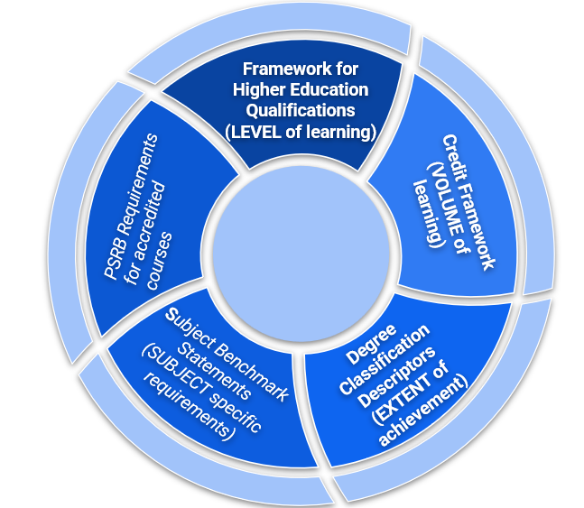
What Are Academic Standards?
(‘sector recognised standards’ in OfS/HERA language)
13
Notes:
How do we meet this?
Standards - Framework for Higher Education Qualifications (FHEQ) - new programmes are designed in line with this - sets building blocks of learning and competencies at each level. We set these and check these when programme and modules are designed, and our external examiners provide us with assurance through the assessment process that these continue to be met. we think carefully about progression through the levels generally in programme design but also when we are redesigning programmes (leanring gaps etc) or admitting students as direct entrants to later stages of study.
credit framework - outlines the volume of learning for students, guides us with the workload associated. we consider credit when we’re designing programmes, thinking about the workload and assessment tasks for modules and the amount of scheduled teaching activities. we tell prospective students through the L&T delivery statement what workload looks like as an UG student, how many hours you need to be studying. and we manage progression and failure by setting limits on the amount of credit that can be carried forward into the next level of study to retake before students need to go part time and redeem that failure. again, to support students to manage that workload and go on to achieve successfully.
FHEQ sets the baseline standards and degree classification descriptors set the norms for classifying bachelors degrees - how does a 2.1 look different to a first. NEW REQ FROM MAY 2022. in process of developing our university policy in this area, intention to present to academic board in july 2022.
IN ITALICS AS NOT REQUIREMENTS Subject Benchmark Statements are not regulatory requirement but are a subject specific national reference point that we also map all programmes to. outline competencies of graduates within certain subject areas.
PSRB requirements for accredited courses we also map to; and we have a number of different processes in place to manage our relationship with professional bodies.

Slide 14
Applying to Study
Admissions Policy
Accreditation of Prior Learning Policy
Student Terms and Conditions
14
Notes:
Admissions Policy - to ensure we admit student fairly and take decisions in their interest
Accreditation of Prior Learning Policy - ensures students who are joining us using prior learning (either through experience or as a certified qualification) for admission or exemption from elements of their HE course, that we consider the implications of this, map their knowledge and learning - to support them with any learning gaps and ensure we take entry decisions in their best interest.
Student Terms and Conditions - outlines rights of students, obligations of university to deliver the service we promise. forms key contractual document at the point of offer making to a student to come and join us.

Slide 15
Delivering and Supporting Learning
Teaching and Learning Activities
Learning and Teaching Delivery Statement
Scheduled Learning Time
Resources - Library, VLE, Wellbeing
Staff Professional Development
Progression and Engagement Support
Collecting Student Feedback
Education Strategy
15
Notes:
this section is very much with the academic staff to deliver, it happens with teaching staff, in the classroom.
Teaching and Learning Activities (seminars, lectures, workshops etc) in accordance with approved programmes, so learning is delivered in a structured way, in particular order and format.
Learning and Teaching Delivery Statement - presents an institutional approach to the balance of online and face to face learning, sets expectations to students about the workload they should expect when they are learning
Scheduled Learning Time - contact time to adhere to credit/volume standards
Education Committee Oversight of Resources to support learning - Library and Learning Services, Writing and Learning Centre, Student Wellbeing Services, Digital Infrastructure (e.g Virtual Learning Environment)
Staff Professional Development (e.g Advance HE)
Progression and Engagement Support- e.g Academic Advising. to identify when students are struggling to achieve/engage in their learning and assessment and put the support in place.
Collecting Student Feedback - mechanisms with course reps, module feedback, the national student survey. helps us assess the extent to which we are delivering a high quality academic experience, supporting learning, and continually improving our approach. we may think that students are understanding information presented in a certain way, but student feedback is crucial in refining and improving
education strategy is framework that defines our objectives around teaching and learning

Slide 16
Reflecting and Revising
Programme Review Procedure
Programme Modification Procedure
Reflection on delivering and supporting learning
Use of Student Outcomes Data
Updating the curriculum Alignment of programmes with strategic themes
Financial viability of programmes
16
Notes:
Reflection on how well delivering and supporting learning has gone
Use data to consideration of student performance and outcomes
Alignment of programmes with strategic themes
Check financial viability of programmes - by considering admissions and retention information. Some low recruiting or performing programmes can lead to suspension of recruitment or closure.
Updating Curriculum - To keep current. this may be due to changes in the discipline; realign of the order or focus of content, in response to professional body requirements; or delivery of new modules.
Programme Modification - this is the process for revising and amending programmes - sometimes this may be in response to external examiner or student feedback, student achievement or a professional body requirement). we change programmes carefully to align with consumer law guidance and our student terms and conditions, so students still receive the product we’ve promised.

Slide 17
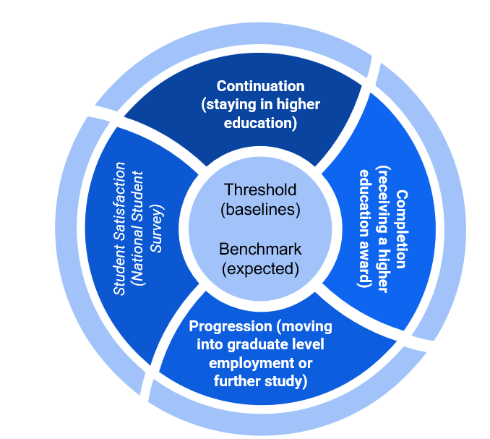
What Are Student Outcomes?
17

Slide 18
Assessing and Awarding
Assessment and Feedback Policy
External Examiners - Subject and Chief
Subject and Central Assessment Boards
Extenuating Circumstances Policy
Academic Misconduct Policy
Appeals Policy
Undergraduate and Postgraduate Academic Framework - progression, classification algorithm
18

Slide 19
Closing Programmes
Suspensions and Discontinuations Policy
Teach Out Plans
Student Terms and Conditions
Student Protection Plan
Programme Design and Approval (for re-designs_
Programme Review (to continue monitoring quality)
19

Slide 20
What about Educational Partners?
Equal regulatory requirements
Often same procedures and policies
Additional mechanisms for supporting partners to meet these standards
Additional mechanisms for monitoring and seeking assurance
Additional administrative and operational frameworks
Risk Management and Partnership Approval Procedure
New resource across key teams
20
Notes:
Equal regulatory requirements
Often same procedures and policies - programme design, approval, modification and review are all same. external examining and assessment all the same.
Additional mechanisms for supporting partners to meet these standards
e.g Link Tutors supporting marking, moderation
approval of teaching staff
Additional mechanisms for monitoring and seeking assurance
e.g meetings/visits/partner review
key performance indicators
Additional administrative and operational frameworks where academic calendars and student lifecycles are different
Risk Management
Additional evidence bases for assurance
Contract management and Partnership Approval Procedure
New resource across key teams

Slide 21
Thank You
Your name
Contact details
04 October 2024

Slide 22
References
Quality Assurance - https://www.bathspa.ac.uk/about-us/governance/academic-governance-and-quality/
Academic Governance - https://www.bathspa.ac.uk/about-us/governance/academic-board/
Academic and Student Policies - https://www.bathspa.ac.uk/about-us/governance/policies/
21/22 Annual Quality and Standards Report (December 2022 BoG Meeting)
Programme Review Statement - https://www.bathspa.ac.uk/media/bathspaacuk/about-us/policies/academic-and-student/Programme-Review-Statement-2022.pdf
Degree Outcomes Statement - https://www.bathspa.ac.uk/media/bathspaacuk/about-us/policies/Degree-Outcomes-Statement.pdf
22

Slide 23
Just One Thing
In your role, reflect on where you engage in quality and standards and when you get information from to do this correctly? | For 10-mins explore the OfS website reviewing where information can be found - worth a bookmark on your browser?
23

