Slide 1




CPD2
Working Together
Aim: The core of our partnership
Duration: 1 hour
Audience: All staff involved in partnership work/delivery
Placeholder EP

Slide 2


Learning Outcomes
Establish the principles of collaboration and working together with the Educational Partners (EP)
Review BSU history, ethos and strategy and its alignment with the EP vision
Clarify contacts and points of access between BSU and EP
Placeholder EP

Slide 3
Content
BSU history, ethos and strategy
What is an educational partnership?
Who is here to help/ key contacts
EP Strategy
Placeholder EP

Slide 4

BSU History & Values
1852 Bath School of Art – Creativity for Good 2023
BSU is a Certified Social Enterprise.
They work with fantastic Educational Partners, certifying course among a range of disciplines from acting,dancing and photography to banking; and located in the UK, UAE, Malta and China
https://www.bathspa.ac.uk/about-us/networks/educational-partners/
Sustainability is at the heart of BSU’s work - Global Citizenship, Fairtrade, Sustainable Development Goals
Notes:
What does it mean for you?
Check the webpage: https://www.bathspa.ac.uk/about-us/
What sustainability and creativity means for you?

Slide 5



BSU values
We challenge our students and staff to realise their talent and thrive, for their own benefit and for the wider good.
Notes:
What does it mean for you?
Check the webpage: https://www.bathspa.ac.uk/about-us/
What sustainability and creativity means for you?

Slide 6

Interactive Activity (1)
I feel proud about XXXX working in my institution
BSU
XXX Partner
Placeholder EP
Notes:
Participants to make a list of values and principles of working at their institution, and checking what of those principles and values also coincide with BSU.
The purpose of this exercise is to find points in common and understand the nature of partnerships where institutions learn from each other.

Slide 7

Strategy 2030
Enablers
We are a university that values the creation of new works as highly as we value research
Talent
We will create an inclusive culture with a holistic approach to work and wellbeing.
Enterprise
We will recognise and cherish the unique spaces in which we learn and work
Creativity
Notes:
Bath Spa University's motto is "thinking through making". The university's core brand behaviors are curiosity, creativity, and confidence.
Bath Spa University's purpose is to:
Challenge students and staff to realize their talent
Thrive for their own benefit and for the wider good
Think and make the world better
The university's Strategy 2030 has four major themes of work: Bath Spa Creativity, Bath Spa Enterprise, Bath Spa Talent, and Bath Spa Enablers

Slide 8
Make it yours
Enablers
Talent
How this relate with your institution and your work?
Enterprise
Creativity
Placeholder EP
Notes:
Participants to make a list of values and principles of working at their institution, and checking what of those principles and values also coincide with BSU.
The purpose of this exercise is to find points in common and understand the nature of partnerships where institutions learn from each other.

Slide 9

Educational Partnerships
These are collaborative, formalised arrangements in place between the University and external education providers where the provider teaches programmes that are quality-assured and awarded by Bath Spa University.
These partnerships can take various forms, though the majority are offered on either a franchised or validated basis and can be delivered either within the UK or internationally.
Placeholder EP

Slide 10
Interactive Activity (2)
What is a partnership?
Use one word, or an image
Placeholder EP
Notes:
The exercise aims at managing expectations from the partnership and the partners, what metaphor applies best and what are the implications of this metaphor for the daily operation, communication, exchange and accountability.

Slide 11

Educational Partnership toolkit
Placeholder EP
Notes:
Temporal Link to Google Drive Transform-ED https://drive.google.com/file/d/1PGCFB01B5vM4Qy4_tKQpnYBtuJ3EFv7p/view?usp=sharing

Slide 12

Teaching Expertise Guide
Supporting staff to develop their expertise in teaching and facilitating student learning.
This will be developed in CPD3-BSU Education Strategy
Placeholder EP

Slide 13
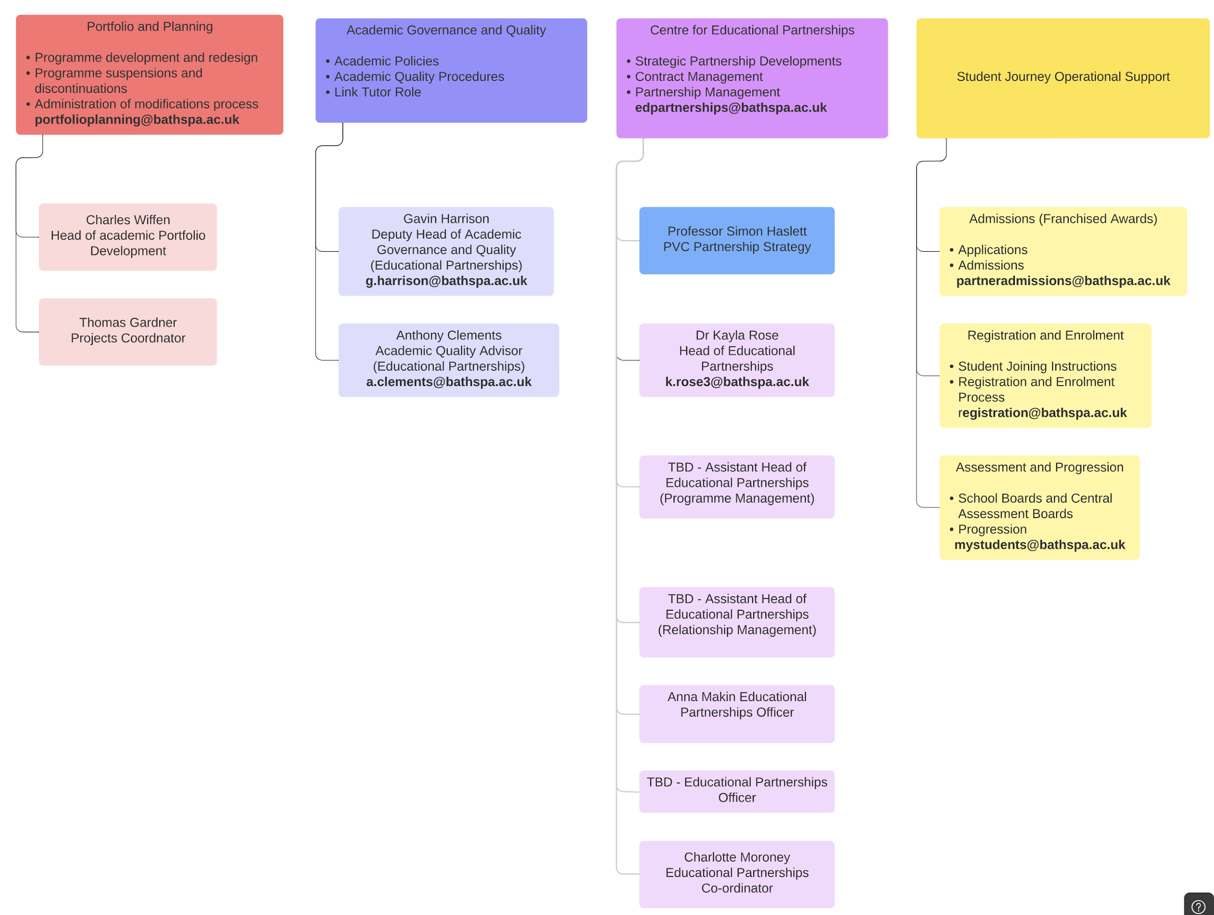
Key contacts at BSU
Notes:
Key Contacts for Educational Partners diagram

Slide 14
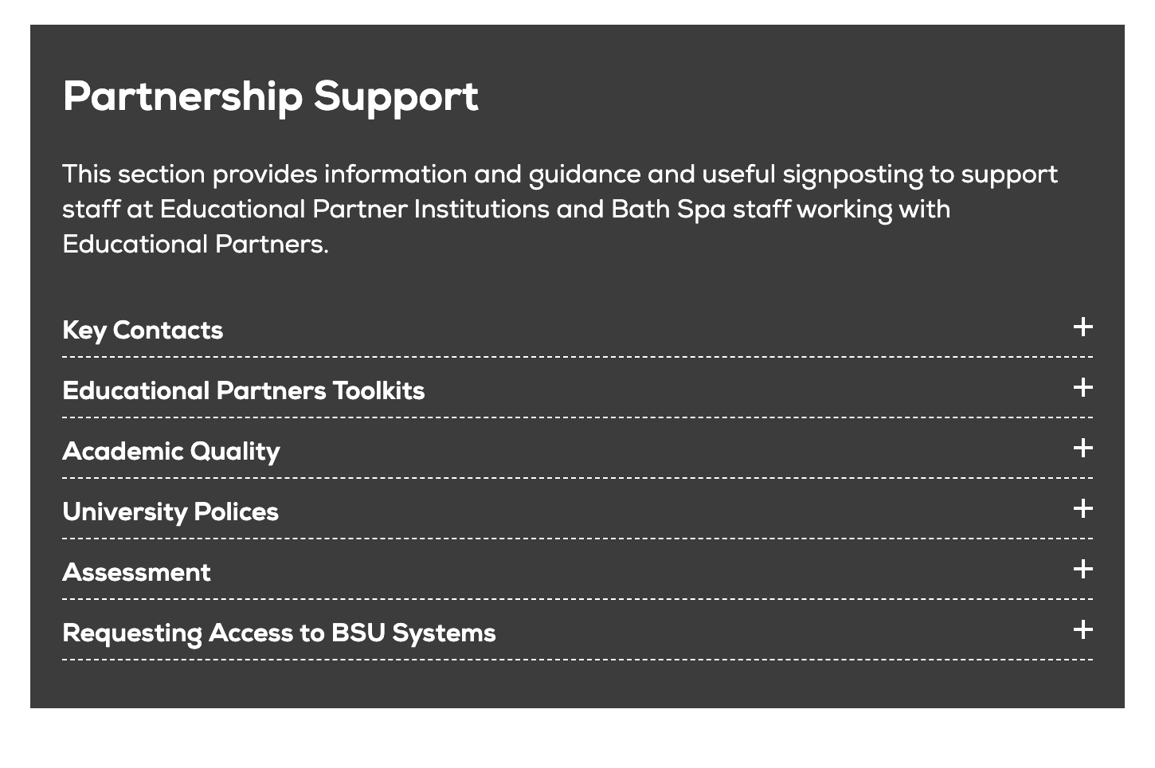
Partnership Support (1)
Visit this site for access to the latest information, support resources, policies and regulations. You will also find a guide on who to contact if you need support.
Notes:
https://www.bathspa.ac.uk/projects/teaching-expertise-guide/educational-partnerships-support-and-resources/

Slide 15

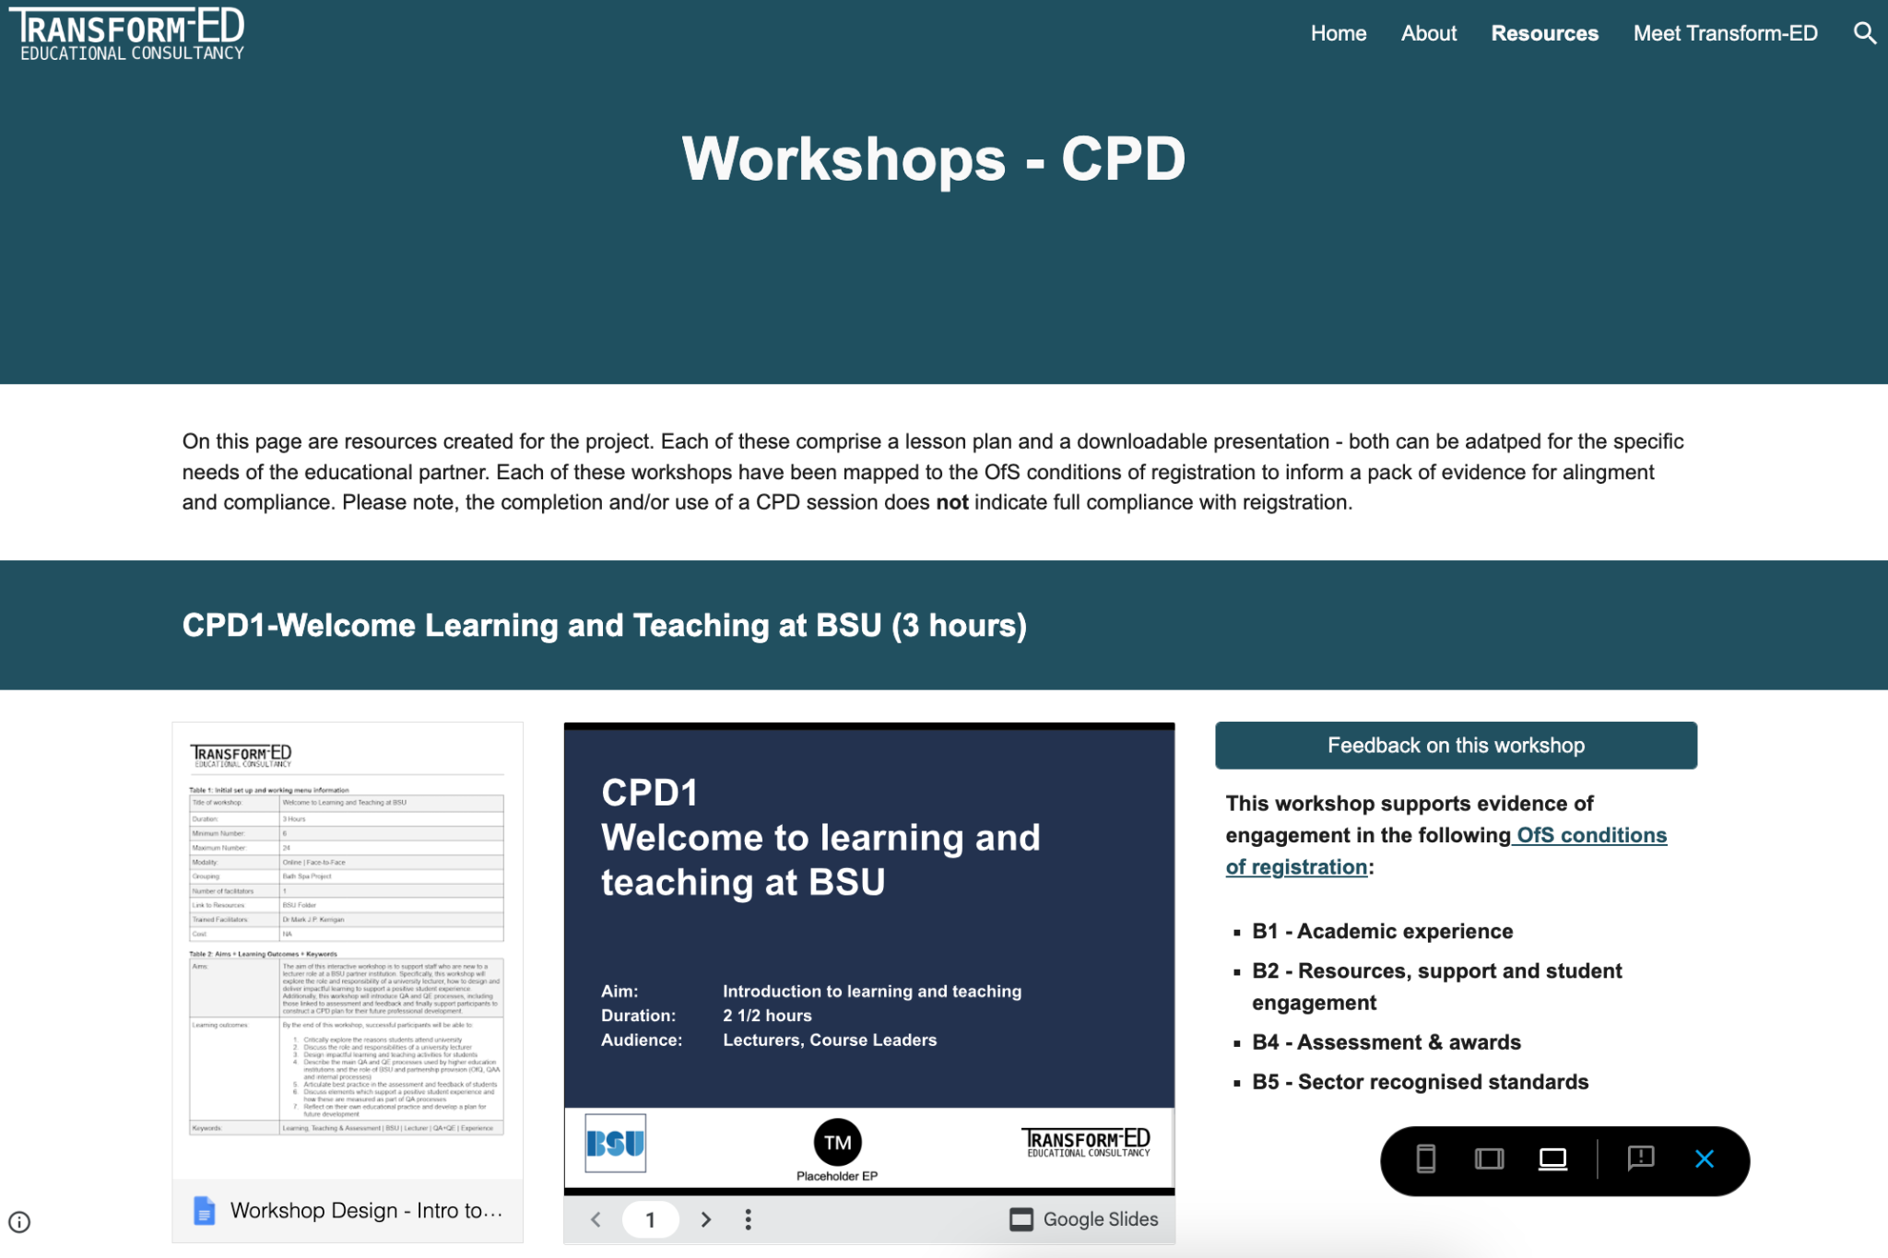
Partnership Support (2)
Placeholder EP
Notes:
This project developed with Transform-ED aims at supporting the Educational Partners. Consider deleting this or hiding it as the Website will change.

Slide 16
CPD list
IDENT | TITLE | DURATION
CPD1 | Introduction to Learning and Teaching at BSU | 3 hours
CPD2 | Working Together - BSU and Educational Partner | 1.hour
CPD3 | Introducing the BSU Educational Strategy | 1.5 hour
CPD4 | Accountability | -
CPD5A | Active Learning and Digital Tools for Engagement | 1 hour
CPD5B | Everything you wanted to know about learning outcomes | 1 hour
CPD5C | Accessible Learning and Teaching | 1 hour
CDP6 | Approaches to Assessment, Marking and Feedback | 2 hours
CPD7 | Generative AI in Learning, Teaching and Assessment | 2.5 hours
CPD8 | Virtual Learning Environment - thoughts + ideas | 0.5 hour
CPD9 | Effective Teaching Practice | 1 hour
CPD10 | Delivering a positive Student Experience | 1 hour
Placeholder EP
Notes:
This project developed with Transform-ED aims at supporting the Educational Partners.

Slide 17
Summary
BSU and [EP] values coincide in focusing on the students experience, diversity, curiosity, accessibility, inclusion
Lecturers are part of the BSU ecology and we can learn from each other
CEP Toolkit - Guidance for collaboration
Placeholder EP
Notes:
What is the one thing you take from this CPD. What makes you curious. What you want to find out more. How can we learn from each other.

Slide 18

Just One Thing
Have a look to the different CPDs and choose one. Let your curiosity to guide you.
Placeholder EP
Notes:
What is the one thing you take from this CPD. What makes you curious. What you want to find out more. How can we learn from each other.

Slide 19
Resources
https://www.bathspa.ac.uk/projects/teaching-expertise-guide/educational-partnerships-support-and-resources/
https://www.bathspa.ac.uk/about-us/governance/academic-governance-and-quality/
Placeholder EP

