Slide 1


CPD1
Welcome to learning and teaching at BSU
Aim: Introduction to learning and teaching
Duration: 3 hours
Audience: Lecturers, Course Leaders

Slide 2

Learning outcomes
By the end of this workshop, successful participants will be able to:
Critically explore the reasons students attend university
Discuss the role and responsibilities of a university lecturer
Design impactful learning and teaching activities for students
Describe the main QA and QE processes used by higher education institutions and the role of BSU and partnership provision
Articulate best practice in the assessment and feedback of students
Discuss elements which support a positive student experience and how these are measured as part of QA processes
Reflect on their own educational practice and develop a plan for future development
2

Slide 3

Activity: Icebreaker
As a way to get us thinking and to get to know each other better. Let’s design a module as a class co-creation activity.
We would like to design a module whereby 100% of students fail. You are the module leader and it is your responsibility to ensure that this target is met.
As a class, shout out suggestions/ideas and we will write these up on the screen/board.
THIS IS A MEASURE OF YOUR CREATIVITY …
3

Slide 4
Indicative content
Student motivations for attending university
Role and responsibilities of a university lecturer
The student HE journey, including ideas for effective management and communication
Effective lesson planning
Constructive alignment
Surface & Deep learning. Active learning.
Principles of good assessment and feedback
Learning outcome construction
FHEQ and academic standards
QA & QE process used within the HE sector (including module evaluation, annual monitoring, student voice, NSS, and PTES)
Construction of a CPD plan
4

Slide 5

BSU Guidance
The information underpinning much of this session, as well as much more, can be found in BSU Teaching Expertise Guide.
https://www.bathspa.ac.uk/projects/teaching-expertise-guide/
5
Notes:
Image is hyperlinked. Click on the image to talk the participants through the guide.
https://www.bathspa.ac.uk/projects/teaching-expertise-guide/

Slide 6
Activity: Why university?
This is an activity to get us thinking about the content of the workshop and to start working together. It will be completed in breakout rooms whereby each room will have its own Digital Canvas (for example Padlet/Zoom WhiteBoard/Lucid Spark or similar).
In your breakout room, explore why students go to university. Add your ideas to the Digital Canvas
The more ideas and thoughts the better!
Rationale - by understanding WHY students go university, it is then possible to design and deliver an impactful and transformative experience.
6

Slide 7

Who regulates Higher Education?
The Office for Students (OfS) regulates all higher education institutions.
Everybody has a role to play in maintaining the required standards and thus delivering a quality education whilst protecting the institution’s registration. The OfS has the power to close institutions.
We are going to explore this role next
7

Slide 8
Your role as a lecturer
The OfS also runs the Teaching Excellence Framework (TEF) which awards institutions a badge from bronze to gold.
Quality teaching including activities & learning materials
Delivering course and modules as validated
Fair and aligned module assessment
Maintaining robust standards
Annual monitoring
Supporting students during their students and helping to ensure positive educational outcomes and achievement
8

Slide 9
The TEF (from the website)
The Teaching Excellence Framework (TEF) is a national scheme run by the OfS that aims to encourage higher education providers to improve and deliver excellence in the areas that students care about the most: teaching, learning and achieving positive outcomes from their studies.
The TEF does this by assessing and rating universities and colleges for excellence above a set of minimum requirements for quality and standards. Universities and colleges that take part in the TEF receive an overall rating as well as two underpinning ratings – one for the student experience and one for student outcomes.
9

Slide 10

TEF ratings
These are important as these demonstrate how well an institution is doing. Additionally, they can impact the funding an institution receives, its reputation and if students choose to study there. The tables can be found here [link to TEF results]
Would you study at a bronze university?
10

Slide 11


OfS Regulatory Framework
This [link] is managed by the OfS (used to be the QAA).
In England, there are levels 4 to level 8 whereby level 4 is the first year at university and level 8 is PHD.
Additionally, there are Subject Benchmark Statements which detail the generic expectations for an award (notes - these are indicative)
11

Slide 12
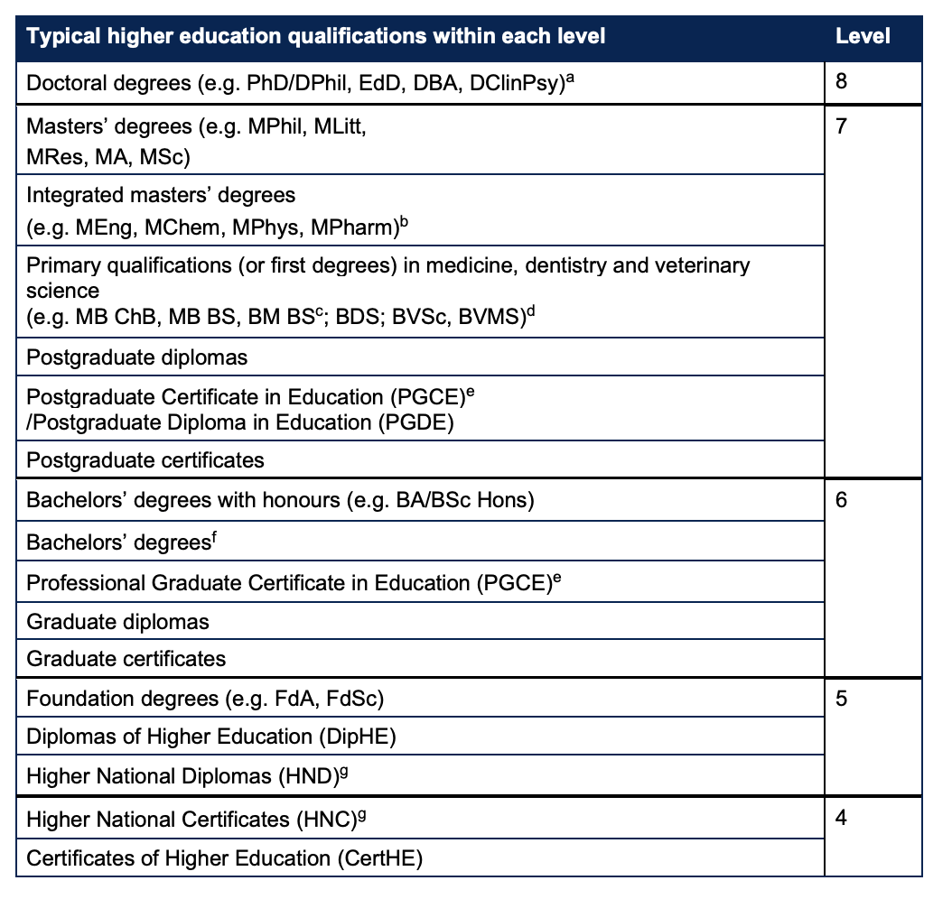
Sector level standards (England)
Framework for Higher Education Qualifications. Managed by the OfS.
In England, there are levels 4 to level 8 Our role as lecturers is to ensure we design and deliver our content at the right level - relates to how we structure our modules and learning outcomes.
Image from Sector Recognised Standards document (England).
12

Slide 13

Some vocabulary (1/4)
Sector Standards + Academic Standards:
The OfS requirements are detailed in this document and it is essential reading for all those designing and delivering learning.
https://www.officeforstudents.org.uk/media/53821cbf-5779-4380-bf2a-aa8f5c53ecd4/sector-recognised-standards.pdf
13
Notes:
https://www.officeforstudents.org.uk/media/53821cbf-5779-4380-bf2a-aa8f5c53ecd4/sector-recognised-standards.pdf

Slide 14
Some vocabulary (2/4)
Subject Benchmark Statements:
‘Subject Benchmark Statements describe the nature of study and the academic standards expected of graduates in specific subject areas. They show what graduates might reasonably be expected to know, do and understand at the end of their studies.
Subject Benchmark Statements are written by subject specialists and we facilitate this process. They are used as reference points in the design, delivery and review of academic programmes. They provide general guidance but are not intended to represent a national curriculum or to prescribe set approaches. Instead, they allow for flexibility and innovation.’
https://www.qaa.ac.uk/the-quality-code/subject-benchmark-statements
14

Slide 15
Some vocabulary (3/4)
Credit-level framework:
‘The award of higher education qualifications is based on the demonstrated achievement of outcomes rather than years of study. Higher education providers are not required to adopt a credit system to define the volume of learning expected of students, although many providers do express their courses by reference to credit. The credit system used in England equates ‘credit’ with ‘learning time’, with 10 notional learning hours equating to one credit. This means that the volume of study for a course expressed in credit provides an indication of the approximate learning time for a student’ Part A of the OfS Sector Recognised Standards] - note previous yellow slide 11.
https://www.officeforstudents.org.uk/media/53821cbf-5779-4380-bf2a-aa8f5c53ecd4/sector-recognised-standards.pdf
15

Slide 16
Some vocabulary (4/4)
Classification Descriptors:
‘Classification descriptors set out the generic outcomes and attributes expected for the award of a bachelors’ degree with a particular classification. They build on the threshold standards set out above in the descriptor for a bachelors’ degree with honours (see A.3.3) and describe the minimum acceptable level of achievement that a student has to demonstrate to be eligible for a particular classification.’ [Part B of the OfS Sector Recognised Standards]
https://www.officeforstudents.org.uk/media/53821cbf-5779-4380-bf2a-aa8f5c53ecd4/sector-recognised-standards.pdf
16

Slide 17

National Student Survey (NSS)
The NSS is the last part of the puzzle. It is an annual student survey completed by students who are just about to graduate.
Results are also public on the Discover Uni undergraduate course search. Prospective students can see what others thought about any course, and it allows them to compare courses at different universities and colleges.
17

Slide 18
NSS question areas (from the website)
The survey asks final year students to provide feedback on their academic experience relating to the following aspects:
Teaching on my Course
Learning Opportunities
Assessment and Feedback
Academic Support
Organisation and Management
Learning Resources
Student Voice
18

Slide 19
Break: 1
Time for a 15-minute break.
19

Slide 20

BSU Education Strategy
This is a key document that all staff teaching BSU named awards need to be familiar with.
‘For all these reasons we will work together as one community, to enable our students to thrive and to support their learning journey during and beyond their programme of study. Our curriculum will be applied and professional, with an emphasis on developing creative, sustainable solutions to local and global challenges. T
hrough the curriculum, the learning environment and our pedagogical approaches, we will prepare our students for diverse and evolving careers that are meaningful to them, and that enable them to be responsible global citizens. We will do this through a personalised and caring approach to learning and wellbeing.’
https://www.bathspa.ac.uk/media/1188b-Education-Strategy-final.pdf
20
Notes:
Image is hyperlinked. Click on the image to talk the participants through the strategy.

Slide 21
Your role as a lecturer (2)
So far we have discussed the OfS, the QAA, Sector Standards and the NSS. What we are going to do in this section is explore what this means for day-to-day activities. Specifically, we are going to explore:
Writing learning outcomes
Designing assessment
Validation and approvals
Delivering effective learning and teaching
21

Slide 22

Delivering and maintaining academic standards.
This is a summary diagram from BSU on the areas that need to be addressed and delivered to maintain academic standards.
22
Notes:
Slide from Pearl

Slide 23
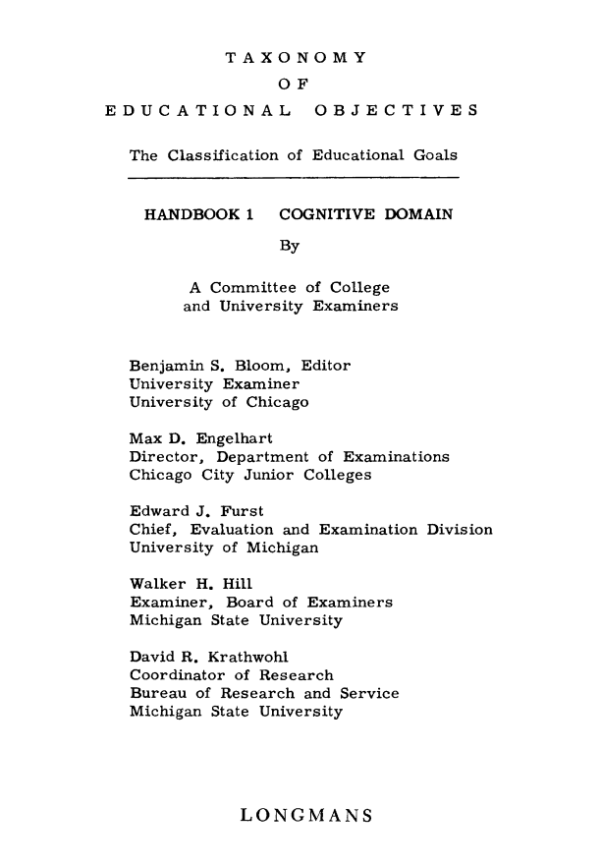
Bloom’s taxonomy (1)
When designing the level of learning, and this aligning to the FHEQ, Bloom’s taxonomy is generally applied.
Written in 1956, it articulates levels of learning.
It was then updated in 2001 by Anderson and Krathwohl into the version often used and/or adapted for different situations today.
23

Slide 24
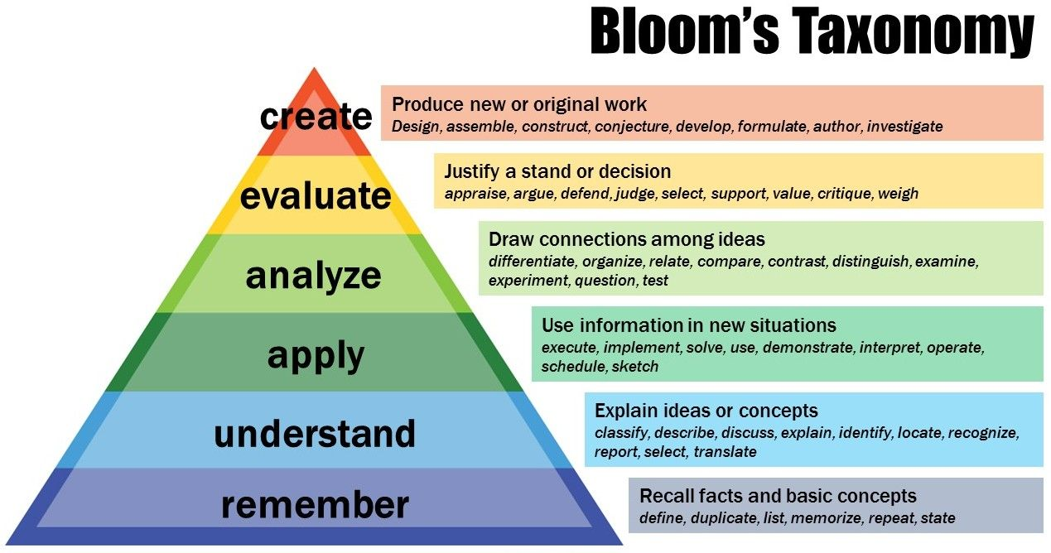
Bloom’s taxonomy (2)
Armstrong, P. (2010). Bloom’s Taxonomy. Vanderbilt University Center for Teaching. Retrieved [November 2024] from https://cft.vanderbilt.edu/guides-sub-pages/blooms-taxonomy/.
24

Slide 25
Intended Learning Outcomes
Intended Learning Outcomes (ILOs) comprise a verb - an active statement detailing what the students are required to do.
Learning and teaching activities
(Designed to meet the learning outcomes)
Assessment methods
(Designed to assess the learning outcomes)
Learning Outcomes
25

Slide 26
It’s all about the verbs
Learning outcomes comprise a verb - an active statement detailing what the students are required to do.
A learning outcome should have one verb only, else they become compound outcomes and challenging to measure.
The verb used determines the academic level (FHEQ) of the learning outcome and this will align with Bloom’s taxonomy.
Additionally, an adverb can be applied to ‘level up’ a verb.
26

Slide 27
Constructing a learning outcome
VERB
ADVERB
SUBJECT
Analyse
Critically
the role of AI in changing how universities approach assessment
Be specific, avoid jargon, do not use multiple ‘ASSESSMENT’ verbs and avoid the use of ‘understand’ as it cannot be measured.
27

Slide 28
Putting it all together
28

Slide 29
Activity: Review these iLOs.
Below are a set of iLOS, in your groups review these addressing the following prompts:
(1) What level of study are they aimed at? (2) How would they be assessed? (3) Are they easy to understand? (4) What should the learner do? (5) Is the iLO fair? (6) Can it be re-written to make it better?
Deconstruct the common narrative on what it means to human and analyse, synoptically, changes and deviations over the past 170 months.
Discuss the role of politics in sharing the UK HE sector.
29
Notes:
Put students into groups to discuss the two LOs. Bring groups together to share ideas and thoughts.

Slide 30

Link to BSU policy/guidance (1)
30
Notes:
This references the presentation from Dr Shaun Mudd on the design of learning outcomes.

Slide 31
Why assessment?
Assessment for Learning
Enables teachers to use information about student’s knowledge, understanding and skills to inform their teaching
Teachers provide feedback to students about their learning and how to improve
Assessment as Learning
Involves students in the learning process where they monitor their own progress, ask questions and practise skills
Students use self-assessment and teacher feedback to reflect on their learning, consolidate their understanding and work towards learning goals
Assessment of Learning
Assists teachers to use evidence of student learning to assess student achievement against learning goals and standards
31
Notes:
Slide from: Dr Shaun Mudd Lorna Lewis
Teaching Expertise Development

Slide 32
Summative & Formative
Formative assessment
Does not count to a student’s grade.
Informs the completion of the summative task
Helps to support student understanding of the assessment task.
Can help with student pacing and meeting deadlines
Engages students with the assessment criteria
Can help to enhance module and degree performance.
Summative assessment
Counts to the module grade and potentially the final degree outcome.
Links to the module specification and validation (cannot be changed without approval)
Subject to intense QA and QE
Needs clear management and student support.
Requires clear understanding for all the markers
Often requires external examiner approval
32
Notes:
Slide from: Dr Shaun Mudd Lorna Lewis
Teaching Expertise Development

Slide 33
NUS Assessment charter (1)
Formative assessment and feedback should be used throughout the programme.
Students should have access to face-to-face feedback for at least the first piece of assessment each academic year.
Receiving feedback should not be exclusive to certain forms of assessment.
Feedback should be timely.
Students should be provided with a variety of assessment methods.
33
Notes:
Slide from: Dr Shaun Mudd Lorna Lewis
Teaching Expertise Development

Slide 34
NUS Assessment charter (2)
There should be anonymous marking for all summative assessment.
Students should be able to submit assessment electronically.
Students should be supported to critique their own work.
Programme induction should include information on assessment practices and understanding marking criteria.
Students should be given a choice of format for feedback.
34
Notes:
Slide from: Dr Shaun Mudd Lorna Lewis
Teaching Expertise Development

Slide 35
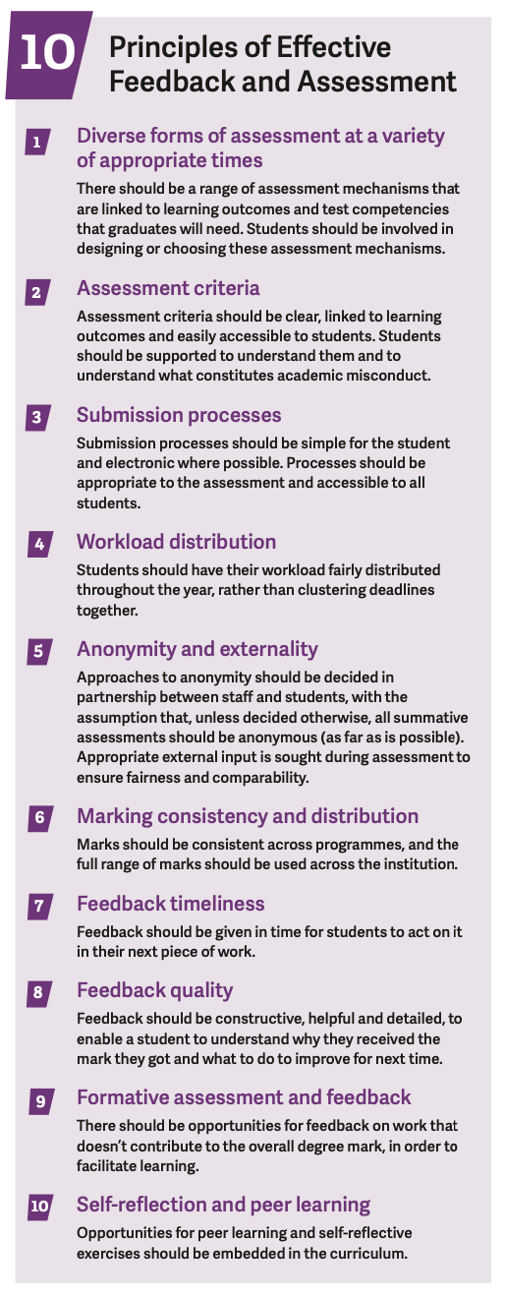
NUS Assessment & Feedback Tool
https://www.qaa.ac.uk/docs/qaas/focus-on/nus-assessment-and-feedback-benchmarking-tool.pdf?sfvrsn=f37cf481_14
35
Notes:
https://www.qaa.ac.uk/docs/qaas/focus-on/nus-assessment-and-feedback-benchmarking-tool.pdf?sfvrsn=f37cf481_14

Slide 36
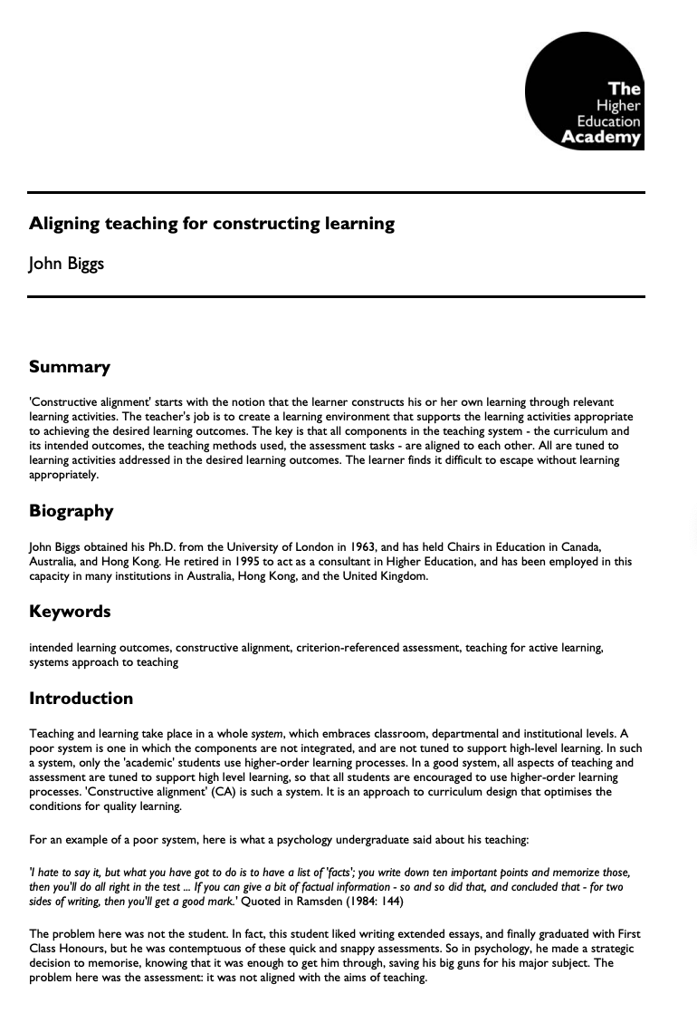
Designing assessment
When designing and planning assessment for a module there are a number of important considerations to consider.
A lot of these relates back to constructive alignment. See Biggs and Tang (2011) - Adapted from Biggs (1999) and Houghton (2004).
This is where the teaching activities, student learning and assessment are aligned whereby the learning activities align with the ILOs and therefore the assessment.
https://www.advance-he.ac.uk/knowledge-hub/aligning-teaching-constructing-learning
36
Notes:
Teaching Expertise Development

Slide 37


Link to BSU policy/guidance (2)
BSU has taken the Ofs requirements and sector best practices and use these to inform and create the assessment and feedback policy. Additionally, they have pulled all the information into a single onsite site (see below).
https://www.bathspa.ac.uk/media/bathspaacuk/about-us/policies/academic-and-student/Assessment-and-feedback-policy.pdf
37
Notes:
Link to a useful policies to read. The documents are hyperlinked and the URLs are also provided. The BSU assessment website is also linked. Please click on this and talk them through it identify the key resources.

Slide 38
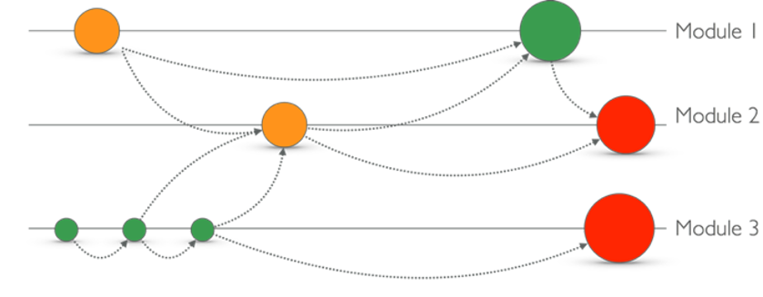
Holistic assessment
Based on work from Uni of Herts & Greenwich.
Green = lower stake | Amber = higher stake | Red = high stake
Assessments in a degree need to link together
38
Notes:
Teaching Expertise Development

Slide 39
(OfS) B5 Sector recognised standards
Part A - Threshold standards:
A1 Conventions for qualification titles at each level (4-8)
A2 Typical volumes of credit for HE qualifications at each level (4-8)
A3 Qualification descriptors
Part B – Classification descriptors
Typical skills and attributes for each classification for Level 6 bachelors’ degrees
39
Notes:
Teaching Expertise Development

Slide 40
(OfS) B4 Effective Assessment, Credible awards
Students are assessed effectively
Each assessment is valid and reliable
Academic regulations are designed to ensure that relevant awards are credible
Academic regulations are designed to ensure the effective assessment of technical proficiency in the English language
Relevant awards granted to students are credible at the point of being granted and when compared to those granted previously.
40
Notes:
Teaching Expertise Development

Slide 41
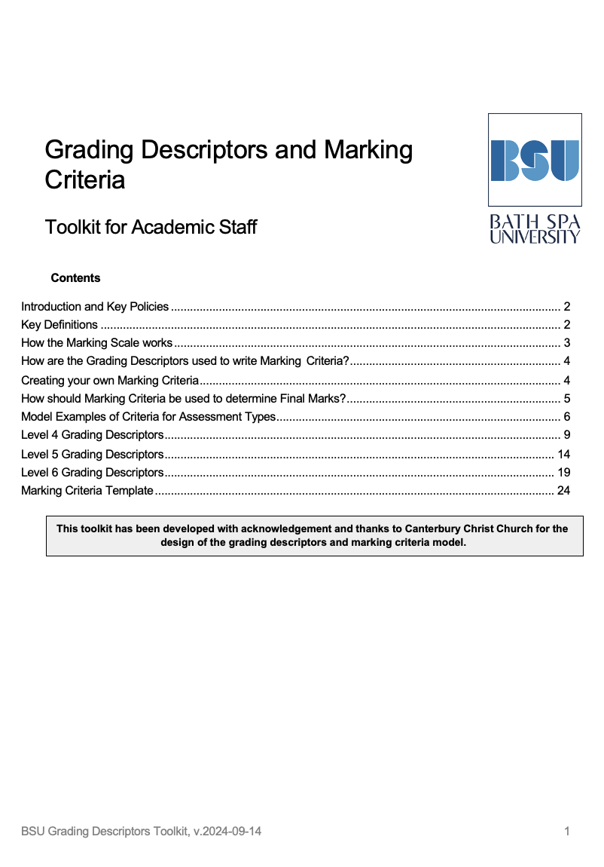
Grading / marking at BSU
BSU has a toolkit which is to be used by all those marking the work of students.
‘This toolkit contains the approved grading descriptors for module assessments undertaken at Levels 4 to 6. It is designed to support academic staff when drafting marking criteria and providing feedback to students and is mapped against UK sector recognised standards for the grading of assessed work.’
‘
https://www.bathspa.ac.uk/media/bathspaacuk/projects/teaching-expertise-guide/Grading-Descriptors-and-Marking-Criteria-Toolkit-v.2024-09-14.docx
41
Notes:
Image to toolkit has been hyperlinked and also provided below.
https://www.bathspa.ac.uk/media/bathspaacuk/projects/teaching-expertise-guide/Grading-Descriptors-and-Marking-Criteria-Toolkit-v.2024-09-14.docx
Teaching Expertise Development

Slide 42
Good marking practice
A clear rubric aligned to the institution’s grading framework is essential (also share this with students).
When marking, review a couple of pieces of work blind and then discuss the grades with the marking team to explore and confirm standards.
Do not make personal judgements (avoid ‘I’) and overall the grading is based on more than one person,
Give clear constructive feedback knowing that it will be shared with others (staff, students, externals, online).
42
Notes:
Slide from: Dr Shaun Mudd Lorna Lewis
Teaching Expertise Development

Slide 43
Giving feedback to students
We give feedback to students but unless they fail they are not able to re-submit their work - so how is the feedback useful? It needs to feed forwards to support future activities, modules and potentially employability.
Importantly, and as part of the NSS, we need to support students to:
Identify when they are receiving feedback (verbal, written, other)
Develop feedback literacy
Apply their feedback to their studies
43
Notes:
Slide from: Dr Shaun Mudd Lorna Lewis
Teaching Expertise Development

Slide 44

Link to BSU policy/guidance (3)
https://www.bathspa.ac.uk/media/bathspaacuk/about-us/policies/academic-and-student/Academic-Regulations-v2.6.pdf
https://www.bathspa.ac.uk/media/bathspaacuk/about-us/policies/academic-and-student/Assessment-and-feedback-policy.pdf
44
Notes:
Links to two useful policies to read. The documents are hyperlinked and the URLs are also provided.

Slide 45
Juwah’s Seven principles (1)
Facilitates the development of self-assessment (reflection) in learning.
Encourages teacher and peer dialogue around learning.
Helps clarify what good performance is (goals, criteria, expected standards).
Provides opportunities to close the gap between current and [pursue] desired performance.
Juwah et al. (2004)
45
Notes:
Slide from: Dr Shaun Mudd Lorna Lewis
Teaching Expertise Development

Slide 46
Juwah’s Seven principles (2)
Provides opportunities to close the gap between current and [pursue] desired performance.
Delivers high quality information to students about their learning.
Encourages positive motivational beliefs and self-esteem.
Provides information to teachers that can be used to help shape the teaching [diagnostic].
Juwah et al. (2004)
46
Notes:
Slide from: Dr Shaun Mudd Lorna Lewis
Teaching Expertise Development

Slide 47
Giving feedback to students (1)
SUBJECT FEEDBACK
LOGISTICAL FEEDBACK
STRATEGIC FEEDBACK
This is feedback on their assessment and in particular in relation to the module learning outcomes and the assessment criteria.
It is about the work and not the student. Avoid ‘I’ and ‘You’ when giving this type of feedback unless the assessment modality requires it.
This is also feedback on their assessment but with a focus on the operational elements. For example, structure, spelling, grammar, referencing, formatting and other non-subject specific elements.
This is also a good place to link to their formative feedback.
This is where feedback should become feedforward and give students actions to enhance further their performance.
Additionally, it is good practice to identify future modules and and assessment whereby they can deliver and target their actions.
47

Slide 48
Giving feedback to students (2)
SUBJECT FEEDBACK
LOGISTICAL FEEDBACK
STRATEGIC FEEDBACK
This is feedback on their assessment and in particular in relation to the module learning outcomes and the assessment criteria.
It is about the work and not the student. Avoid ‘I’ and ‘You’ when giving this type of feedback unless the assessment modality requires it.
This is also feedback on their assessment but with a focus on the operational elements. For example, structure, spelling, grammar, referencing, formatting and other non-subject specific elements.
This is also a good place to link to their formative feedback.
This is where feedback should become feedforward and give students actions to enhance further their performance.
Additionally, it is good practice to identify future modules and and assessment whereby they can deliver and target their actions.
The two red circles are areas where feedback will help students to understand their received grade.
48
Notes:
The two red circles are areas where feedback will help students to understand their received grade.

Slide 49

Moderation
Internal Moderation
by Partner
Internal Moderation
by BSU
External Moderation by External Examiner
Accuracy (how closes to the target)
Precision (how close to each other)
49
Notes:
Text from: Dr Shaun Mudd Lorna Lewis
Teaching Expertise Development

Slide 50
Link to BSU policy/guidance (4)
See section 7 of this policy for guidance on Moderation
Additional slides and information can be found in CPD 6
7c - of this policy relates to moderation by external partners
https://www.bathspa.ac.uk/media/bathspaacuk/about-us/policies/academic-and-student/Assessment-and-feedback-policy.pdf
50
Notes:
Links to two useful policies to read. The documents are hyperlinked and the URLs are also provided.

Slide 51
Any questions?
Notes:
Slide from: Dr Shaun Mudd Lorna Lewis
Teaching Expertise Development

Slide 52
Reflection and future planning (1)
In this session, we have covered a lot of material and it will be useful to spend a couple of minutes on personal reflection around the following questions:
What information is new information for me?
Are there areas I need to follow up on?
How will what I learnt today impact my professional practice?
52

Slide 53
Reflection and future planning (2)
In this session, we have covered a lot of material and it will be useful to spend a couple of minutes on personal reflection around the following questions:
What information is new information for me?
Are there areas I need to follow up on?
How will what I learnt today impact my professional practice?
53

Slide 54
Activity: Reflection and future planning
We have given you a template to write up to four SMART objectives that you wish to take away from this session.
These can then be used to direct and inform your personal CPD.
Drawing from your reflections, let’s spend the next few minutes writing and discussing these.
54

Slide 55
References
https://web.archive.org/web/20201212072520id_/https://www.uky.edu/~rsand1/china2018/texts/Bloom%20et%20al%20-Taxonomy%20of%20Educational%20Objectives.pdf
https://haqaa2.obsglob.org/wp-content/uploads/2020/11/2001_Anderson_A-taxonomy-for-learning-teaching-and-assessing.-A-Revision.pdf
https://quincycollege.edu/wp-content/uploads/Anderson-and-Krathwohl_Revised-Blooms-Taxonomy.pdf
https://s3.eu-west-2.amazonaws.com/assets.creode.advancehe-document-manager/documents/hea/private/resources/id477_aligning_teaching_for_constructing_learning_1568036613.pdf
https://www.enhancingfeedback.ed.ac.uk/documents/id353_senlef_guide.pdf
https://www.qaa.ac.uk/docs/qaas/focus-on/nus-assessment-and-feedback-benchmarking-tool.pdf?sfvrsn=f37cf481_14
https://www.officeforstudents.org.uk/for-providers/regulatory-resources/the-regulatory-framework-for-higher-education-in-england/
https://www.officeforstudents.org.uk/media/cffb3feb-c7ed-472d-8ad3-008175099a6b/sector-recognised-standards-in-england.pdf
55

Slide 56
Thank You
Your name
Contact details
04 October 2024

Slide 57


Just One Thing
If you were to think back on all your education experiences, you will remember teacher’s names, lessons, coursework, activities and grades.
Reflect on how you want your students to remember you and what you need to do to make this happen…..
57

